Slide 1


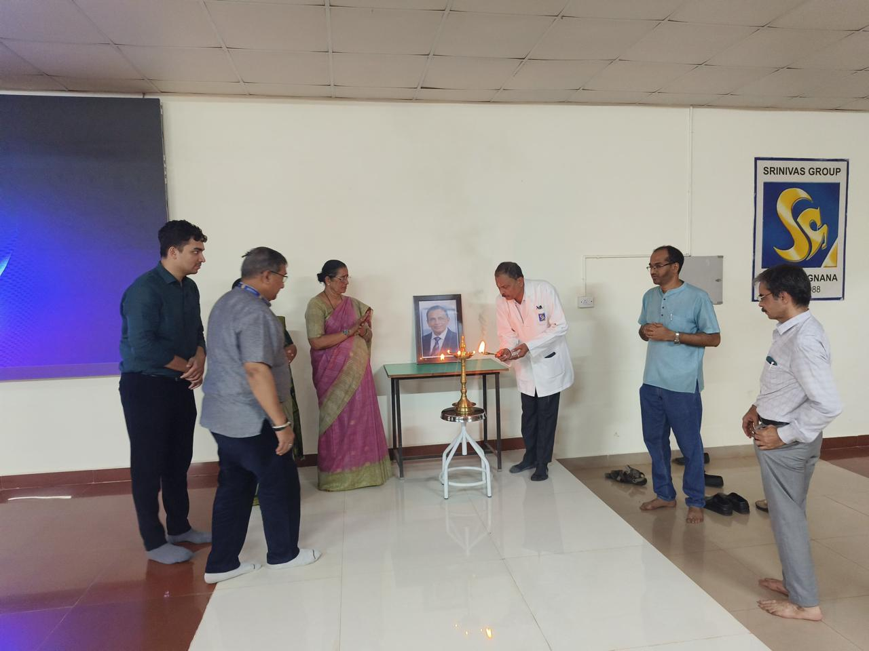
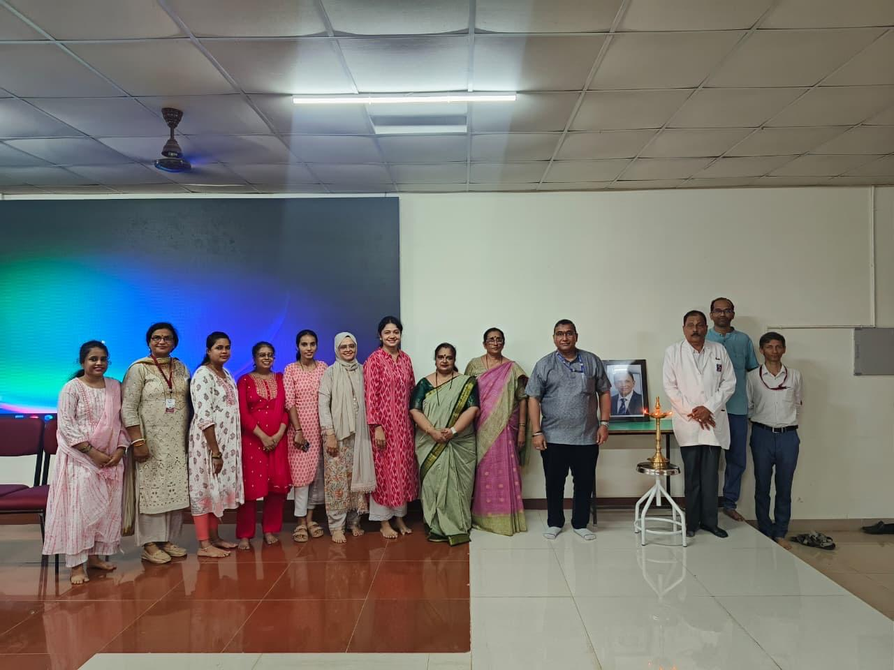
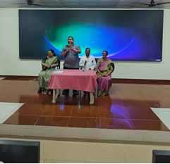
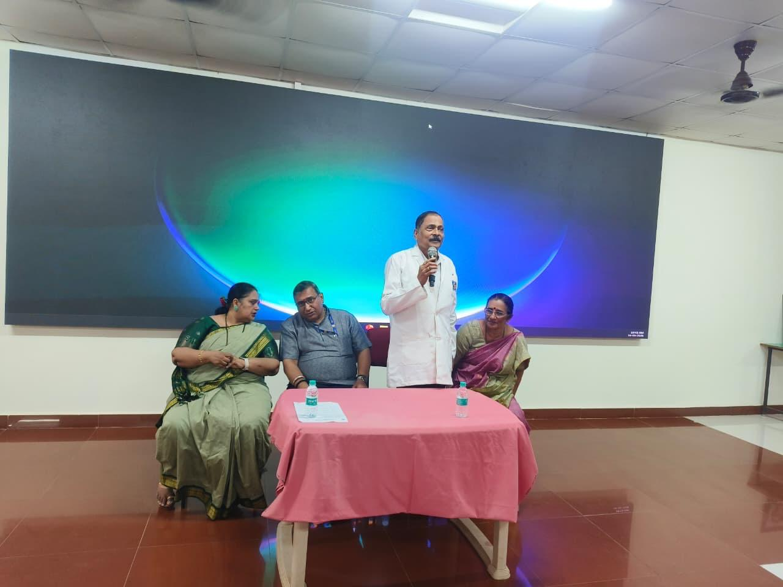
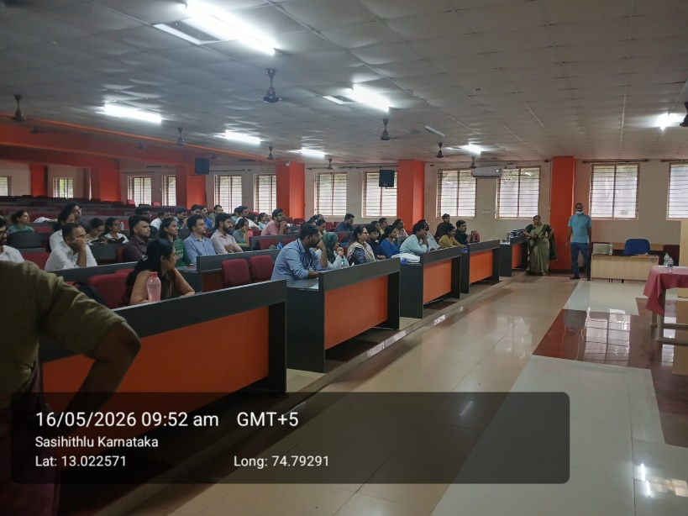
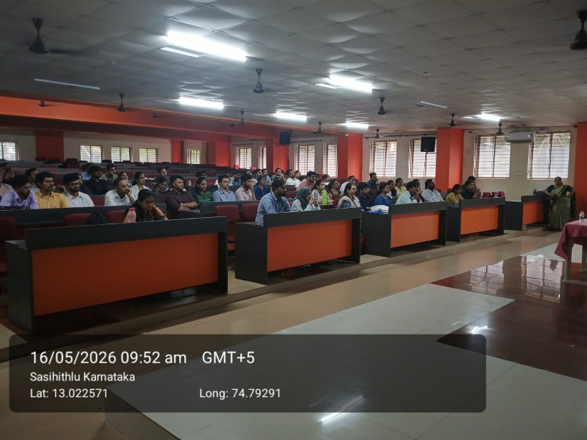
SRINIVAS INSTITUTE OF MEDICAL SCIENCES & RESEARCH CENTRE
SRINIVASNAGAR, MUKKA, MANGALORE – 574146. D.K
DISSERTATION & METHODOLOGY WORKSHOP FOR MEDICAL POSTGRADUATES

Slide 2
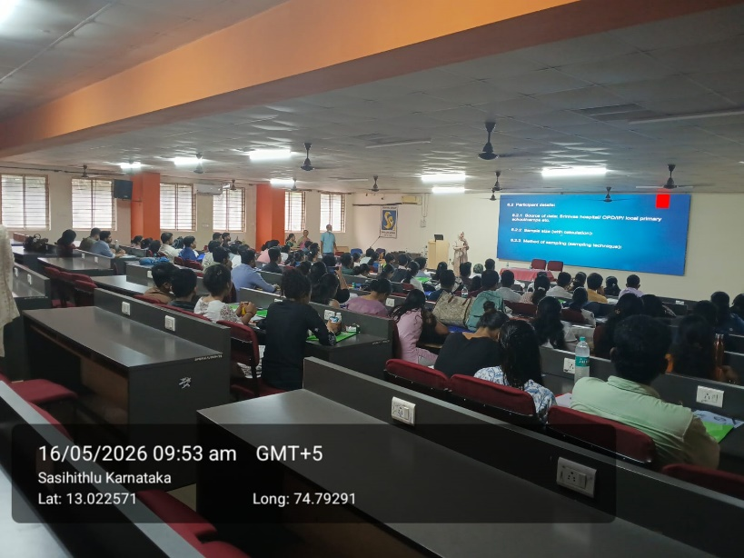
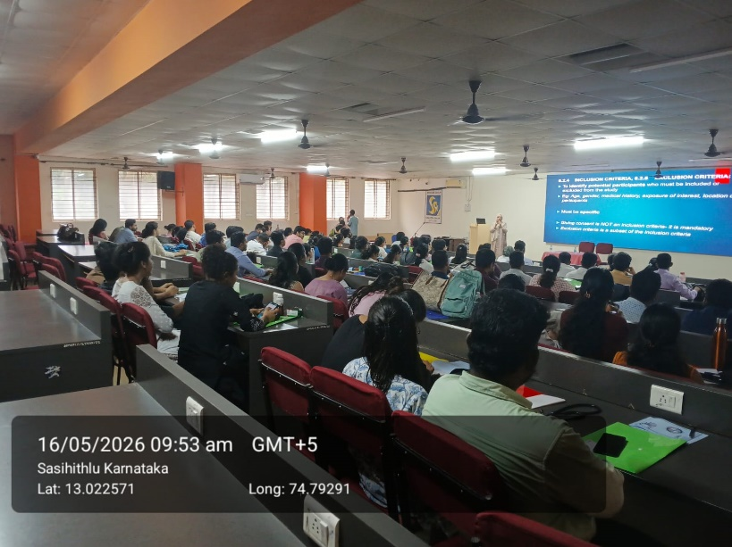
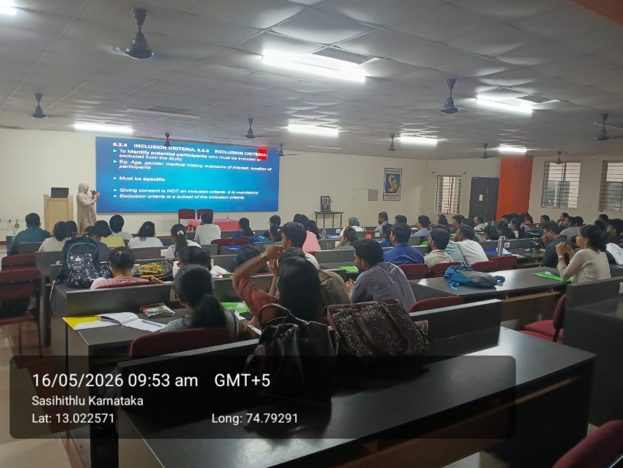
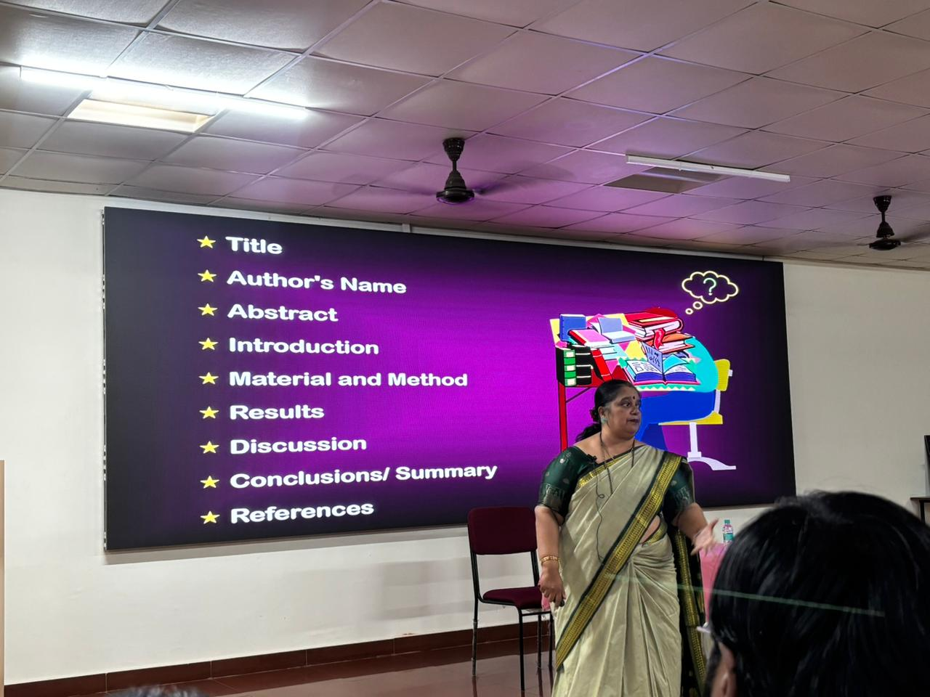
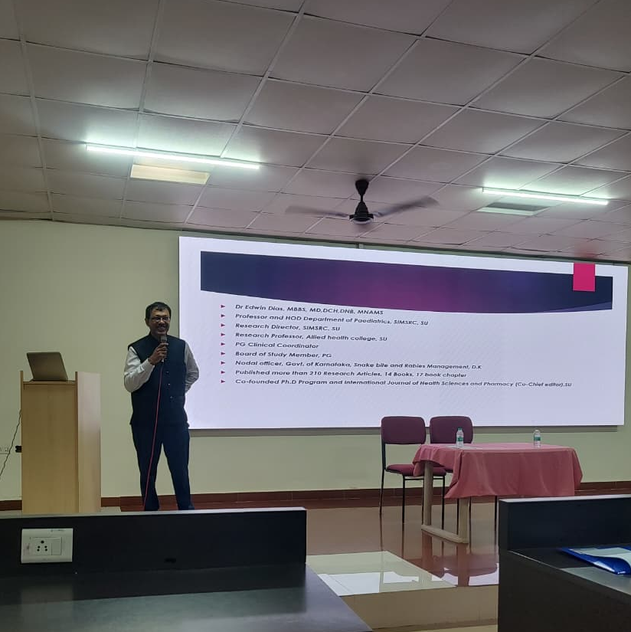
SRINIVAS INSTITUTE OF MEDICAL SCIENCES & RESEARCH CENTRE
SRINIVASNAGAR, MUKKA, MANGALORE – 574146. D.K
DISSERTATION & METHODOLOGY WORKSHOP FOR MEDICAL POST GRADUATES

Slide 3
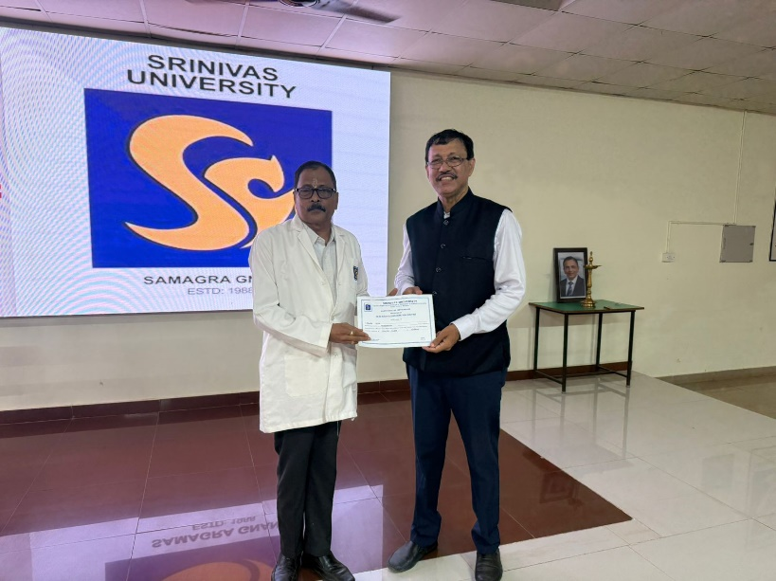
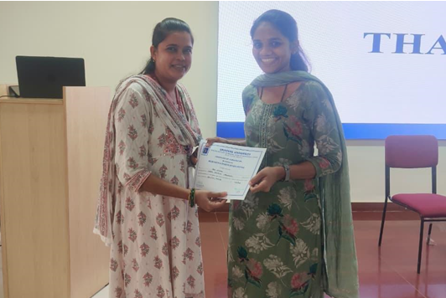
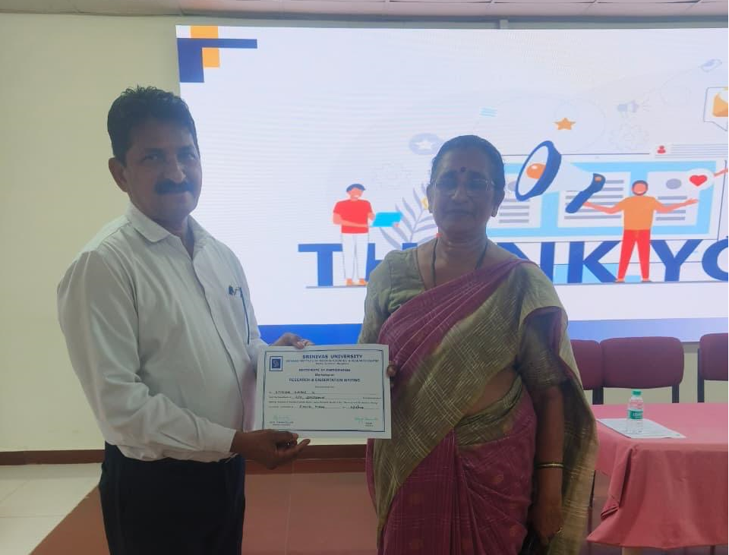
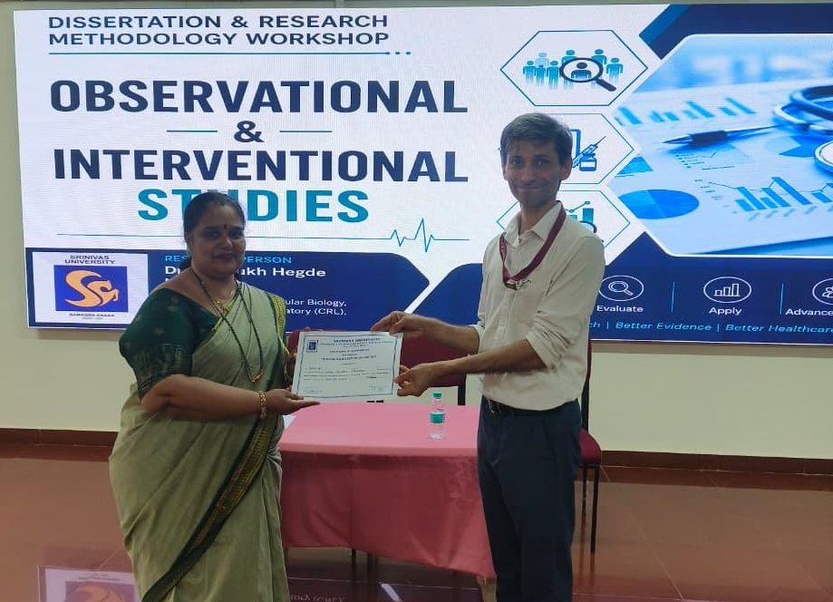
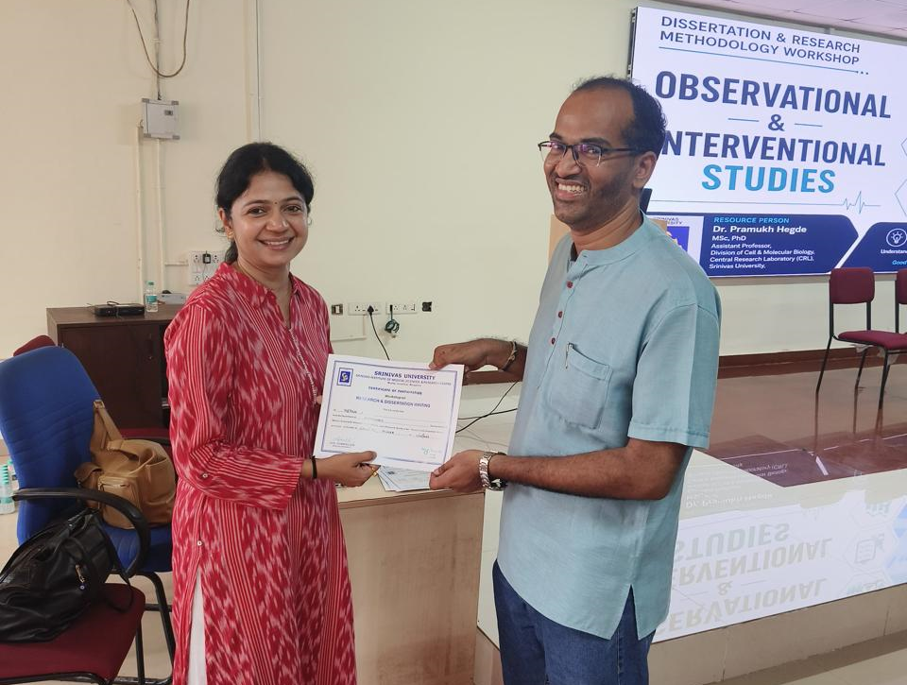
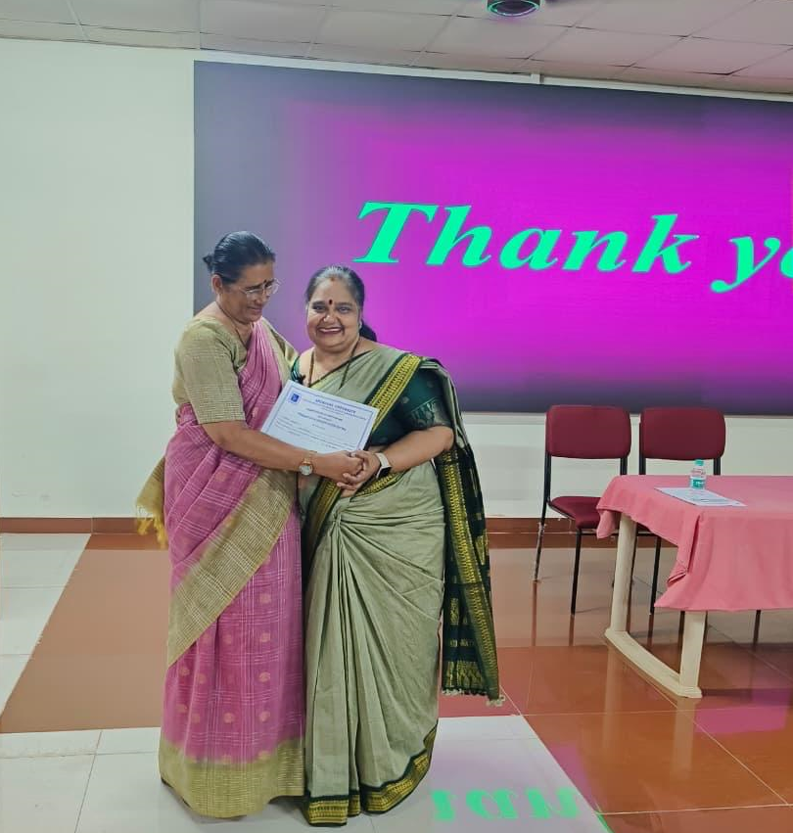
SRINIVAS INSTITUTE OF MEDICAL SCIENCES & RESEARCH CENTRE
SRINIVASNAGAR, MUKKA, MANGALORE – 574146. D.K
DISSERTATION & METHODOLOGY WORKSHOP FOR MEDICAL POST GRADUATES

Slide 4
SRINIVAS INSTITUTE OF MEDICAL SCIENCES & RESEARCH CENTRE
SRINIVASNAGAR, MUKKA, MANGALORE – 574146. D.K
DISSERTATION & METHODOLOGY WORKSHOP FOR MEDICAL POST GRADUATES
THANK YOU

