Slide 1


SRINIVAS INSTITUTE OF MEDICAL SCIENCES & RESEARCH CENTRE
SRINIVASNAGAR, MUKKA, MANGALORE – 574146. D.K
WORLD MENTAL HEALTH DAY PROGRAMME
Venue: SIMS & RC
Date: 10-10-2025

Slide 2
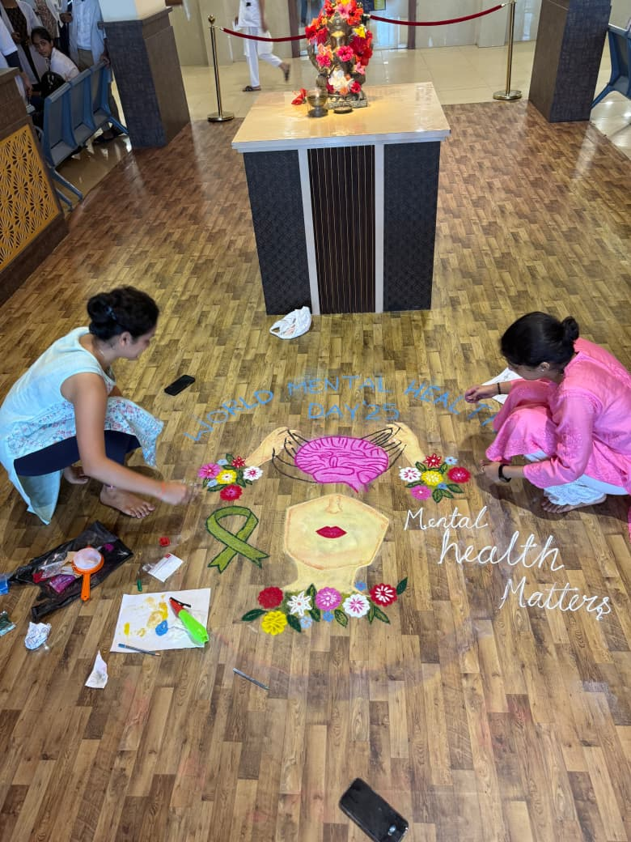
SRINIVAS INSTITUTE OF MEDICAL SCIENCES & RESEARCH CENTRE
SRINIVASNAGAR, MUKKA, MANGALORE – 574146. D.K
FLORAL ART

Slide 3
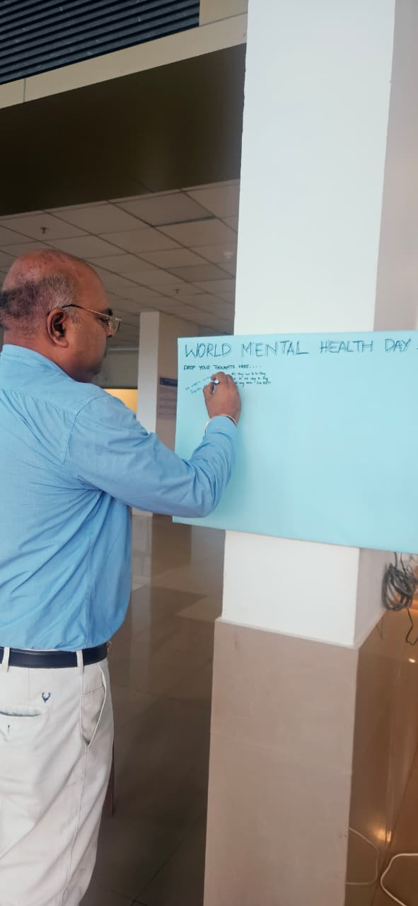
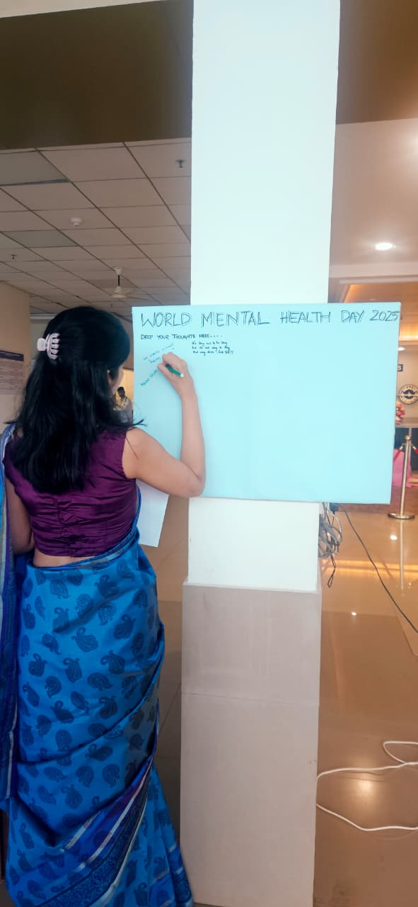
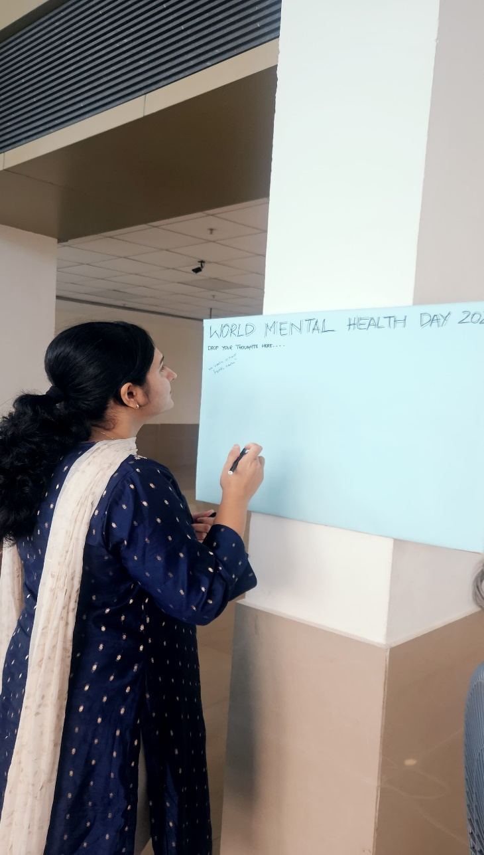
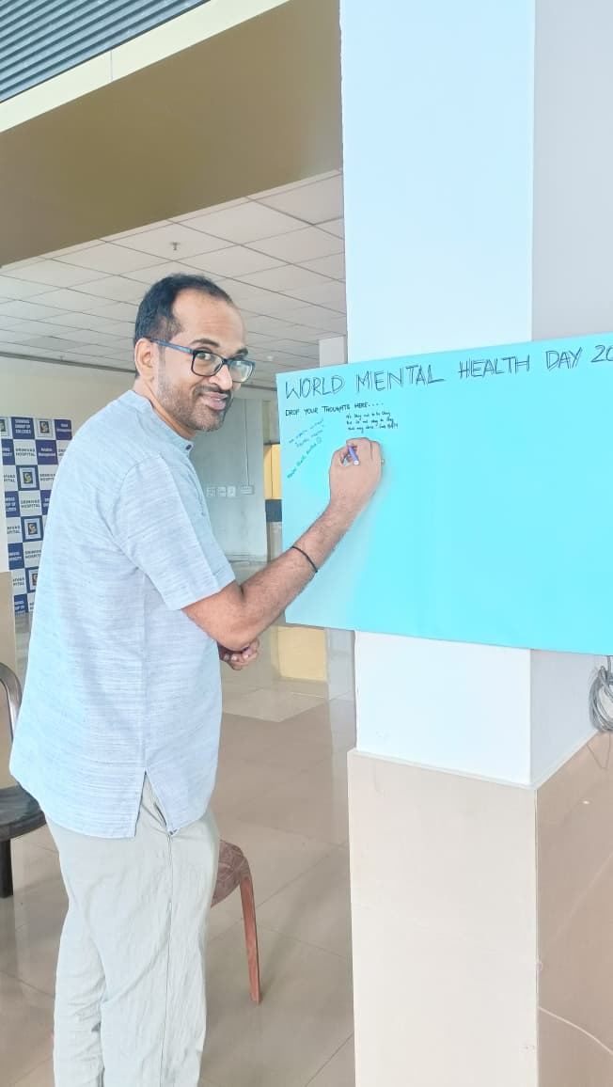
SRINIVAS INSTITUTE OF MEDICAL SCIENCES & RESEARCH CENTRE
SRINIVASNAGAR, MUKKA, MANGALORE – 574146. D.K
SLOGAN WRITING

Slide 4
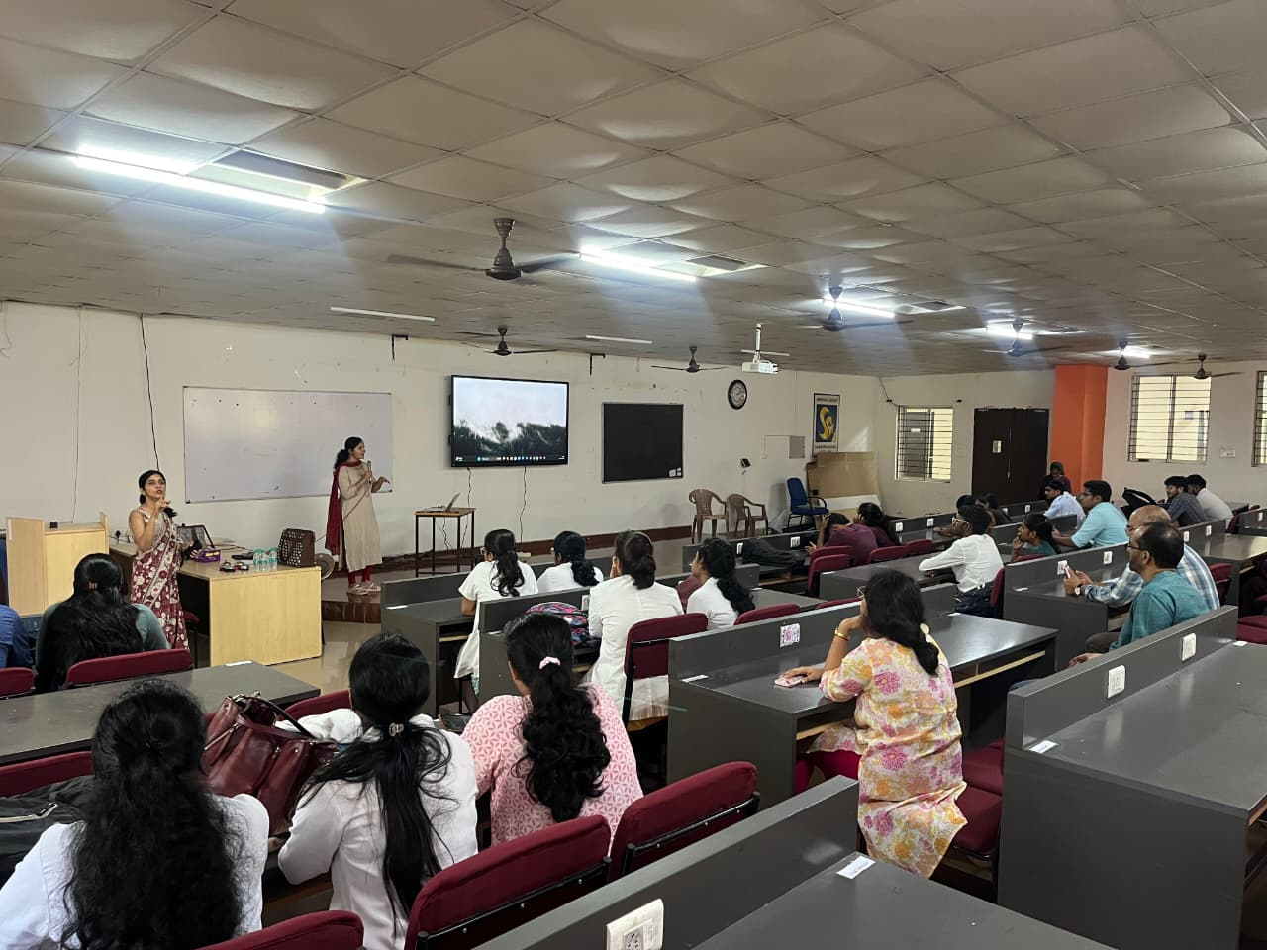
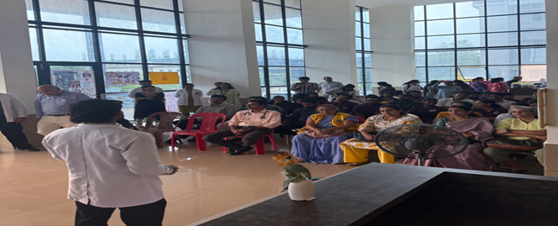
SRINIVAS INSTITUTE OF MEDICAL SCIENCES & RESEARCH CENTRE
SRINIVASNAGAR, MUKKA, MANGALORE – 574146. D.K
DELIBERATIONS ON MENTAL ISSUES & RESOLVES

Slide 5
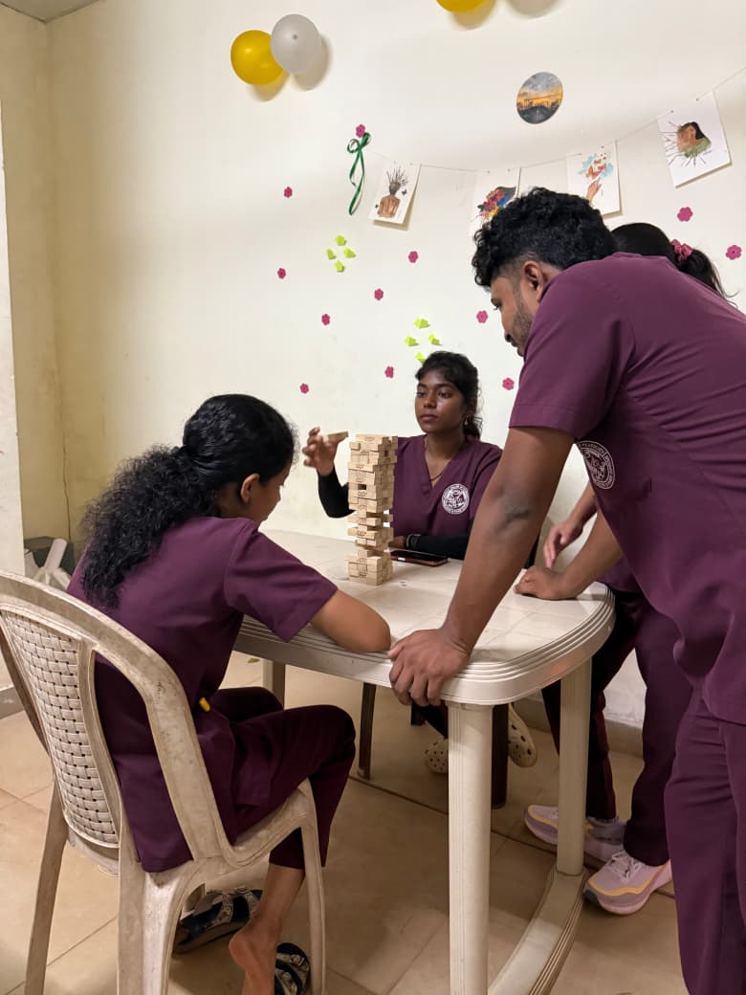
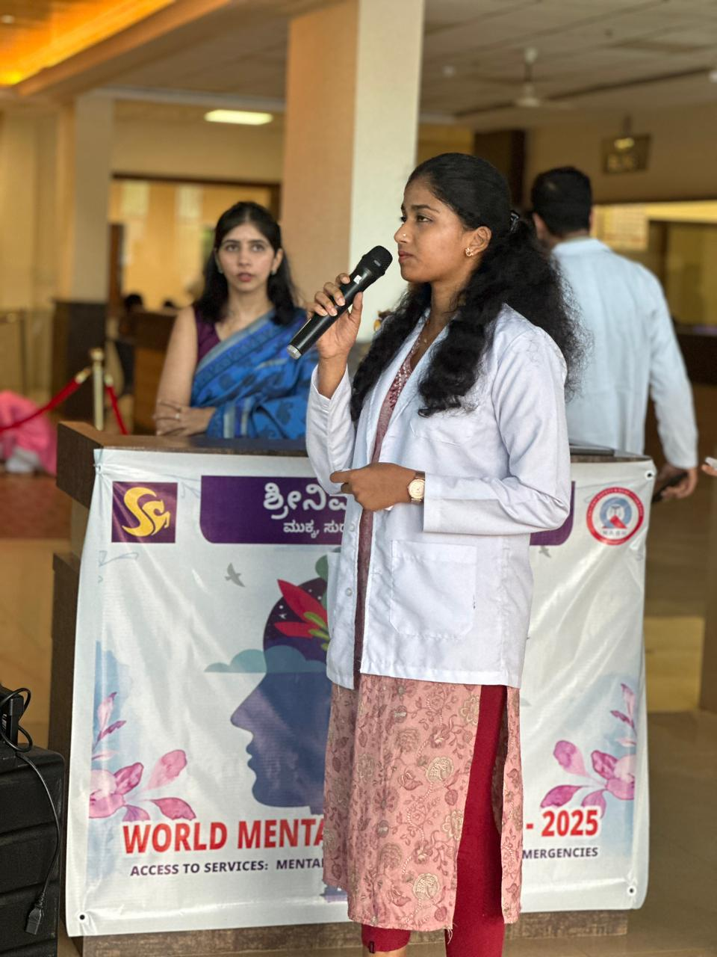
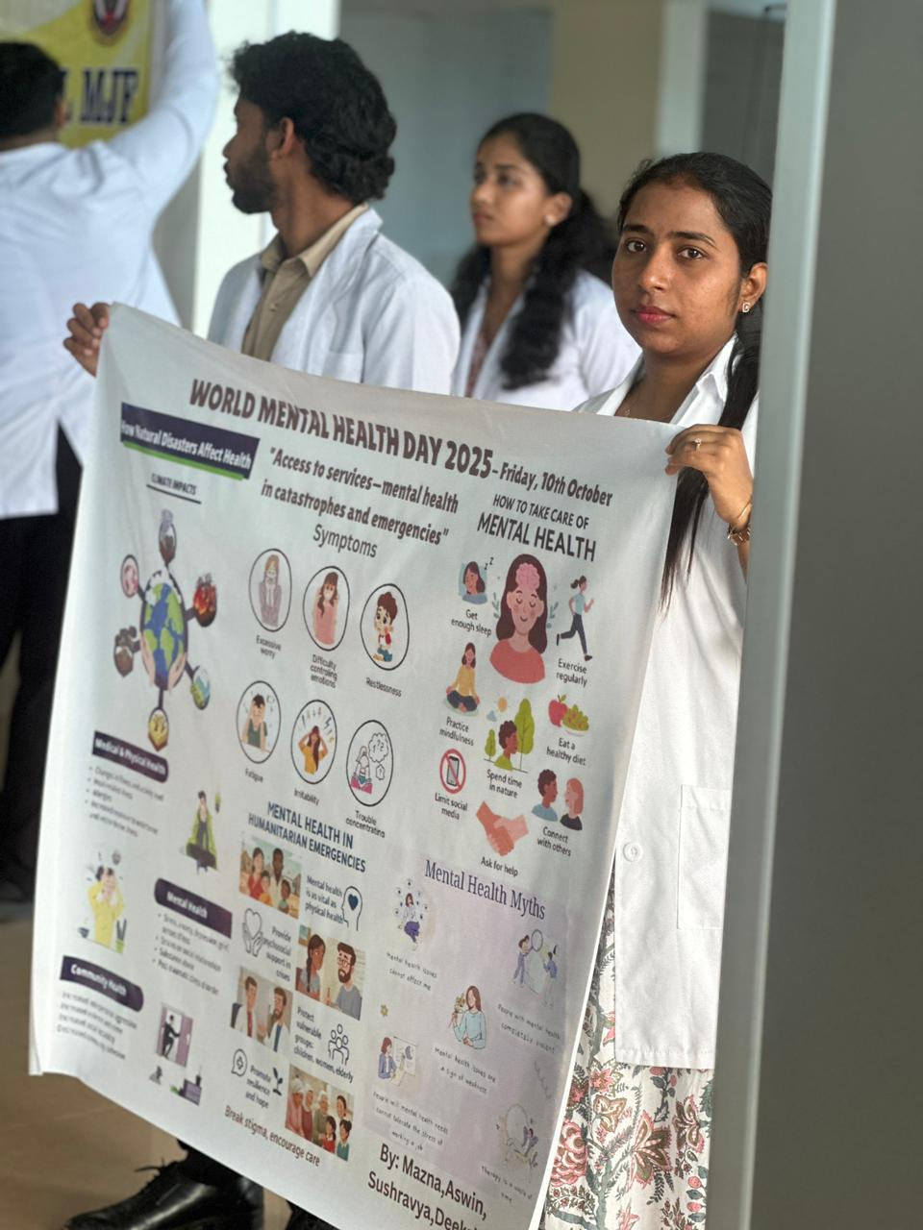
SRINIVAS INSTITUTE OF MEDICAL SCIENCES & RESEARCH CENTRE
SRINIVASNAGAR, MUKKA, MANGALORE – 574146. D.K
MENTAL FITNESS TIPS

Slide 6
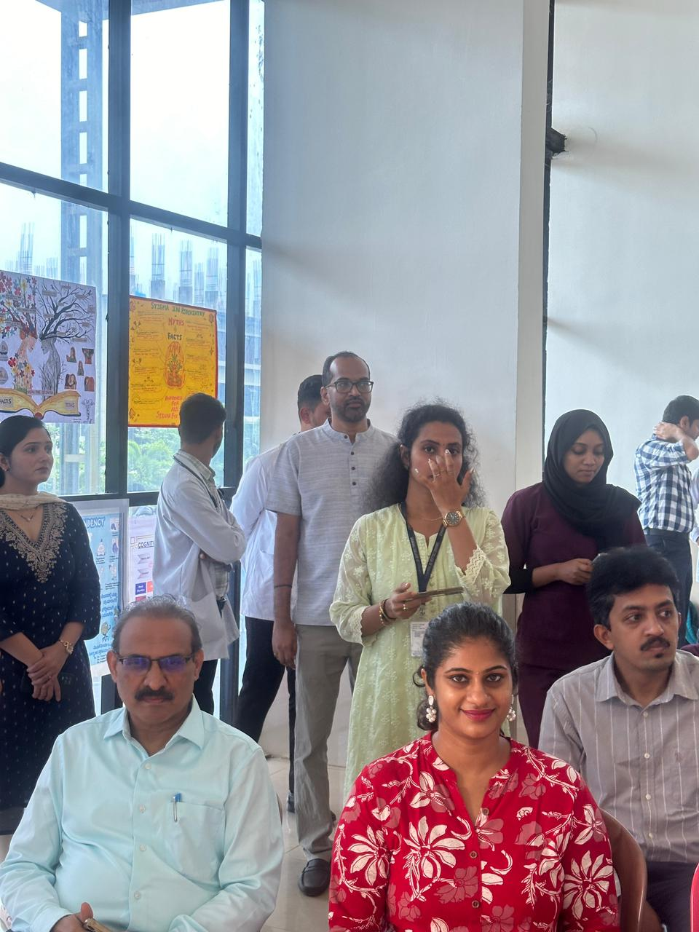
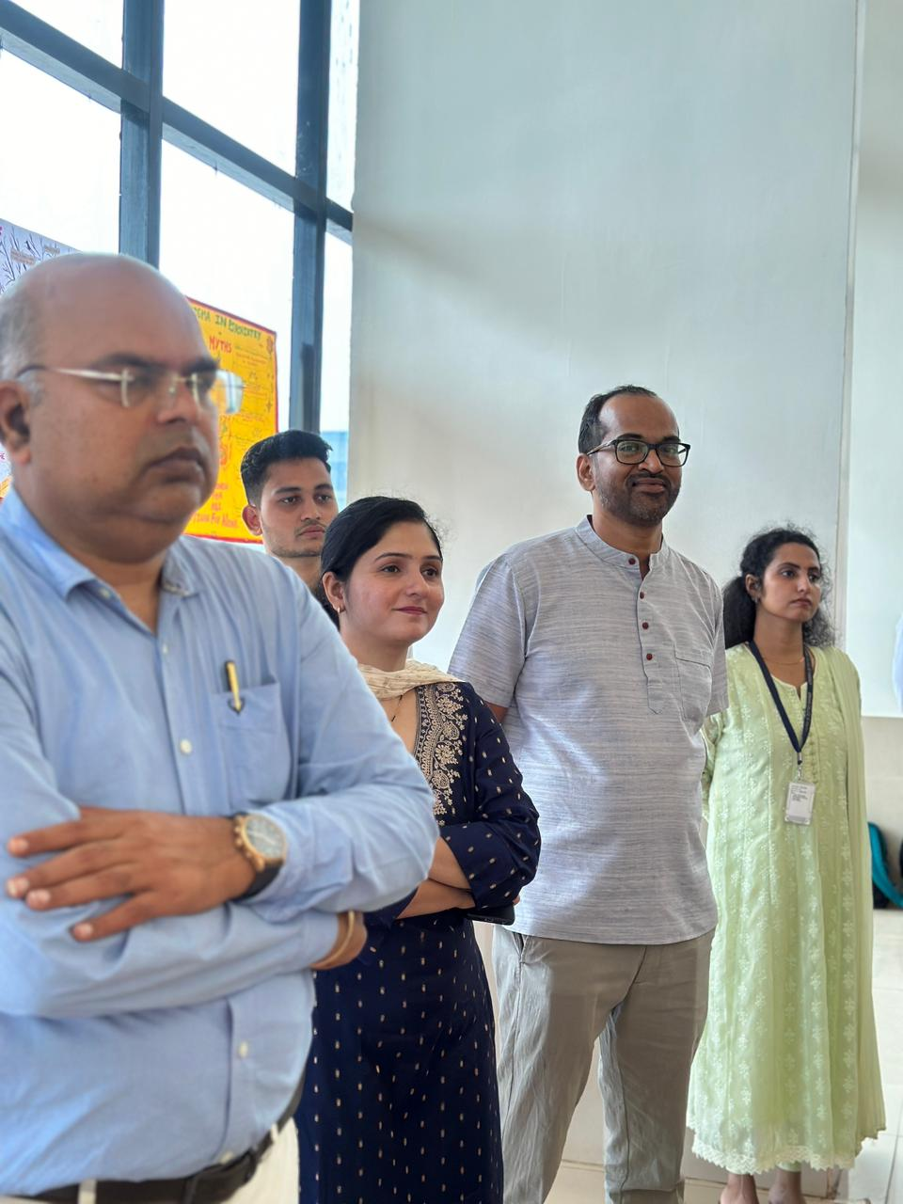
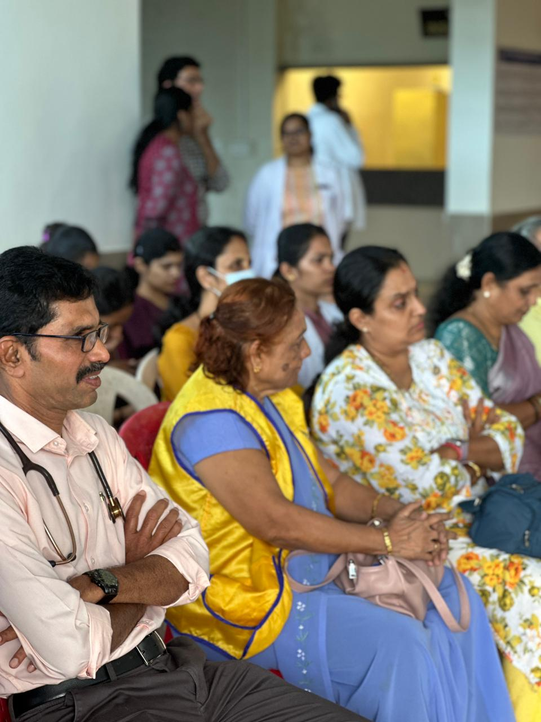
SRINIVAS INSTITUTE OF MEDICAL SCIENCES & RESEARCH CENTRE
SRINIVASNAGAR, MUKKA, MANGALORE – 574146. D.K
VIEWS

Slide 7
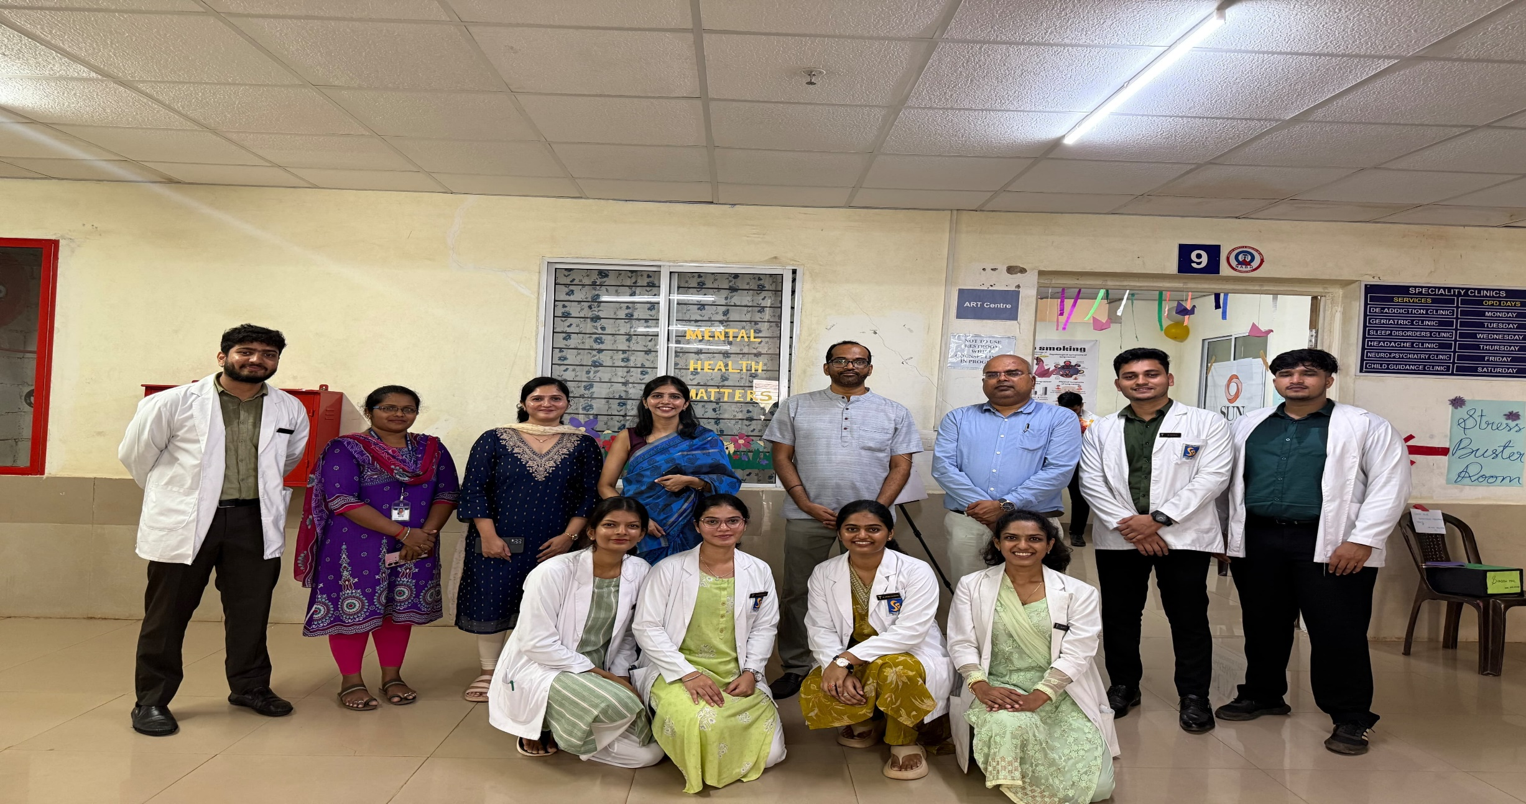
SRINIVAS INSTITUTE OF MEDICAL SCIENCES & RESEARCH CENTRE
SRINIVASNAGAR, MUKKA, MANGALORE – 574146. D.K
TEAM PSYCHIATRY

Slide 8
SRINIVAS INSTITUTE OF MEDICAL SCIENCES & RESEARCH CENTRE
SRINIVASNAGAR, MUKKA, MANGALORE – 574146. D.K
"Mental Health is Wealth,"

