Slide 1


SRINIVAS INSTITUTE OF MEDICAL SCIENCES & RESEARCH CENTRE
SRINIVASNAGAR, MUKKA, MANGALORE – 574146. D.K
INTELLECTUAL PROPERTY RIGHTS
FACILITATION WORKSHOP
Date: 12-11-2025

Slide 2
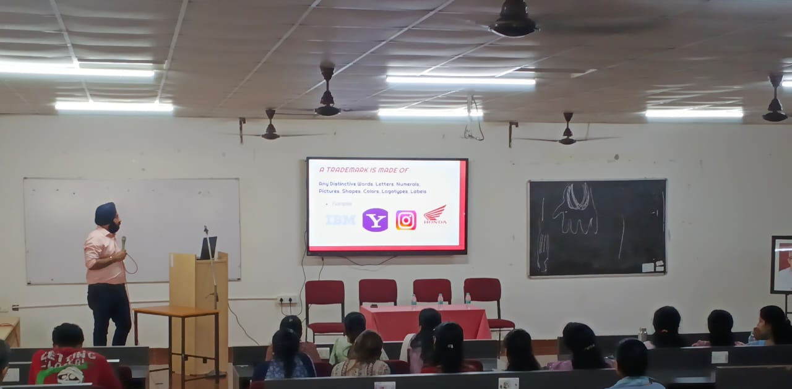
SRINIVAS INSTITUTE OF MEDICAL SCIENCES & RESEARCH CENTRE
SRINIVASNAGAR, MUKKA, MANGALORE – 574146. D.K
PREFACE

Slide 3
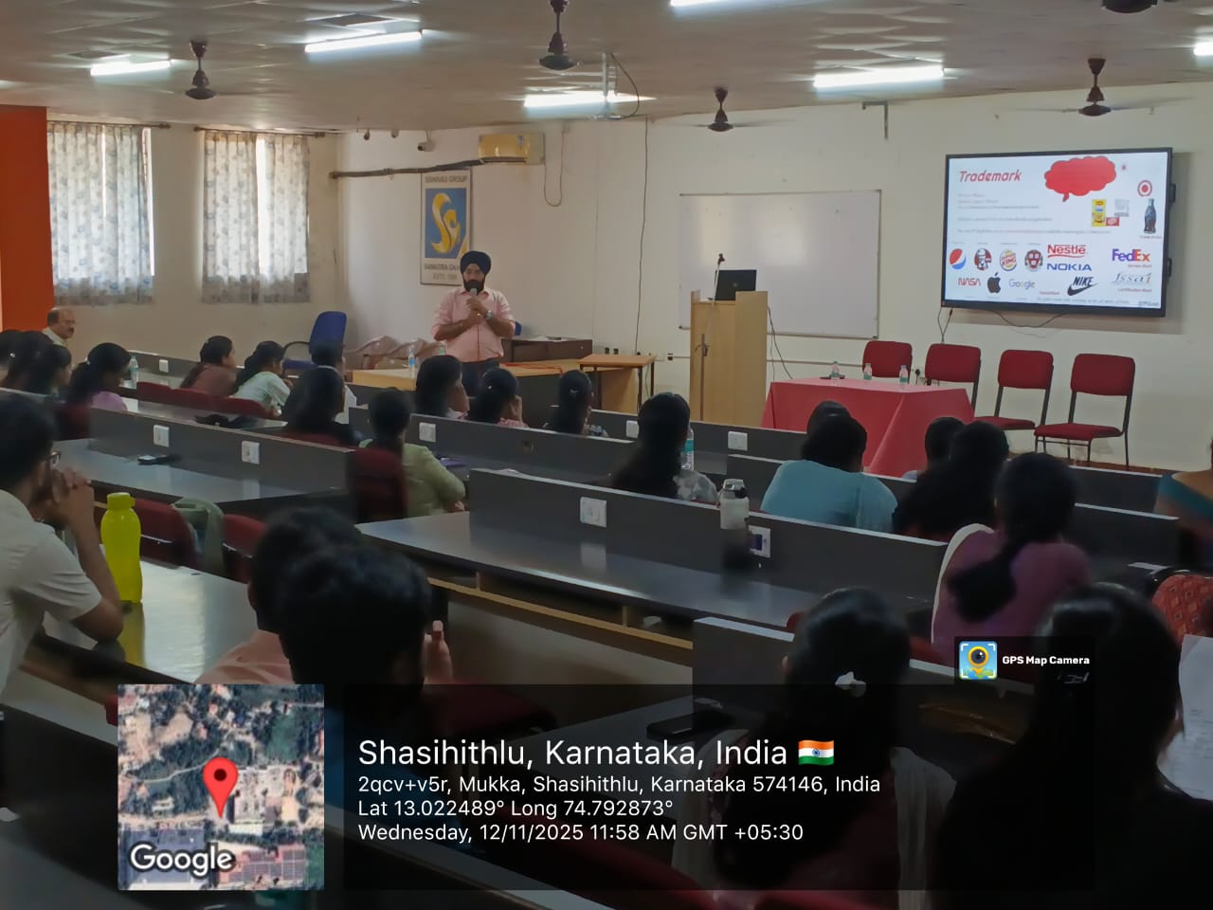
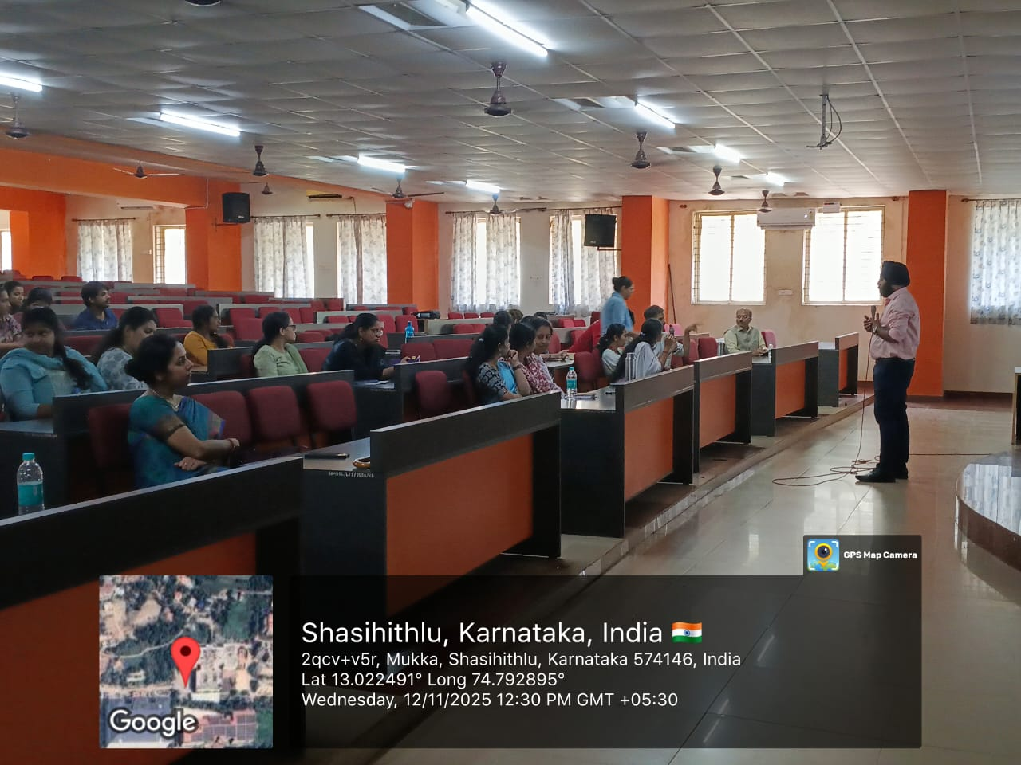
SRINIVAS INSTITUTE OF MEDICAL SCIENCES & RESEARCH CENTRE
SRINIVASNAGAR, MUKKA, MANGALORE – 574146. D.K
INSIGHTS ON IPR PROCESS

Slide 4
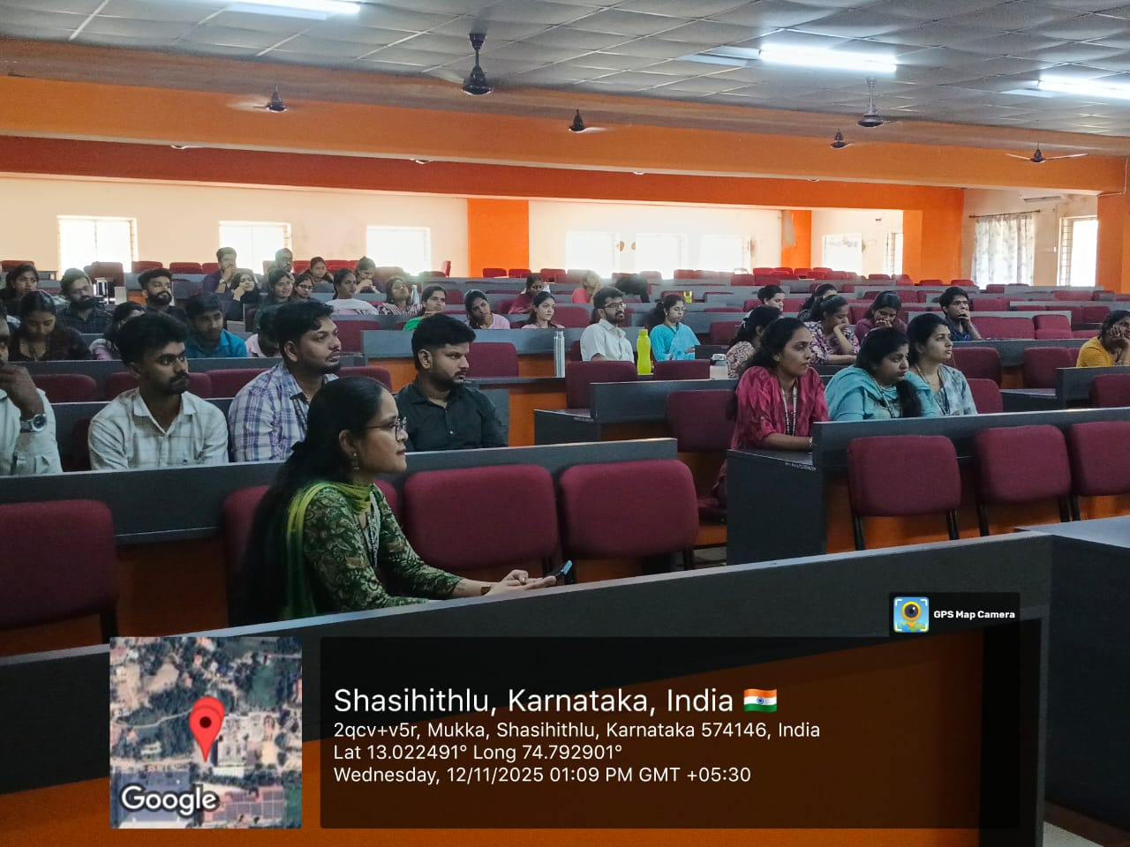
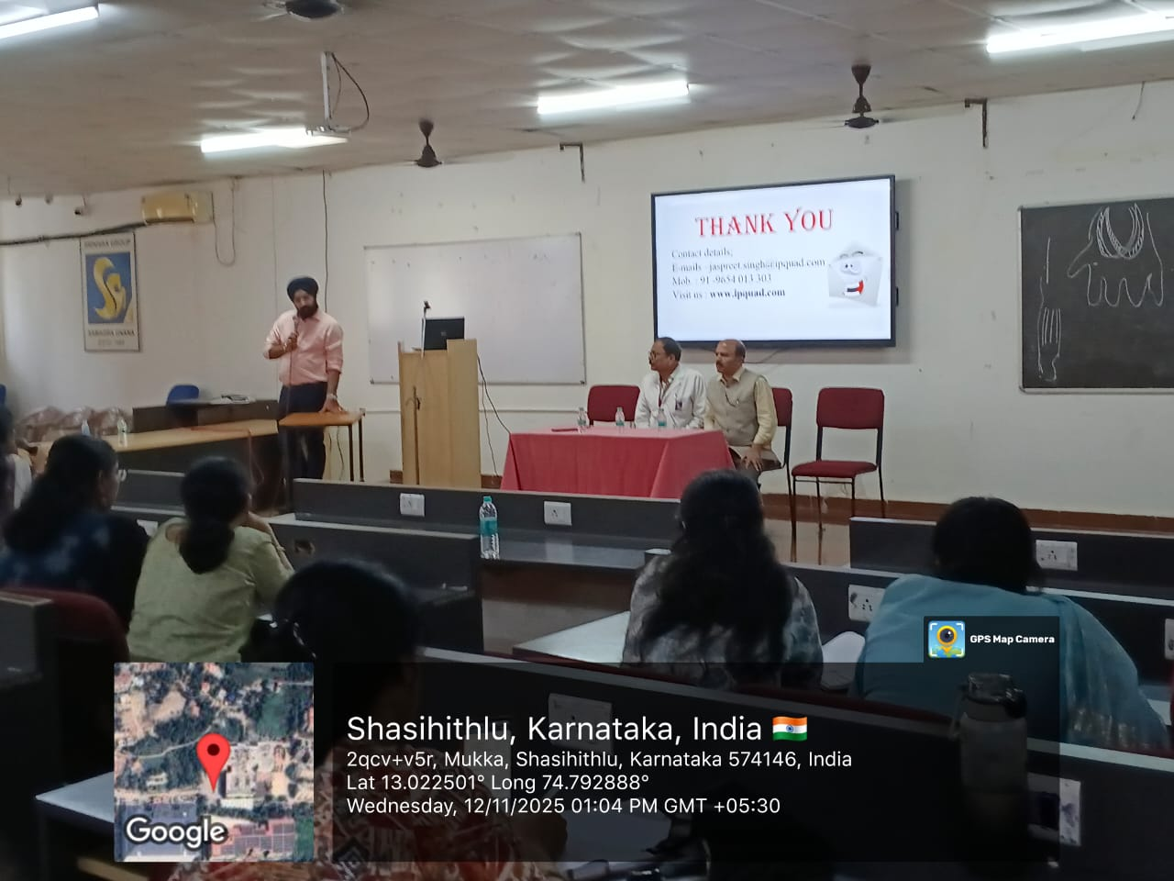
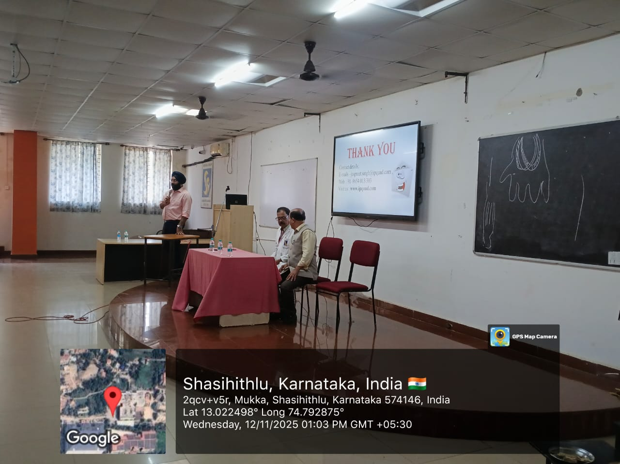
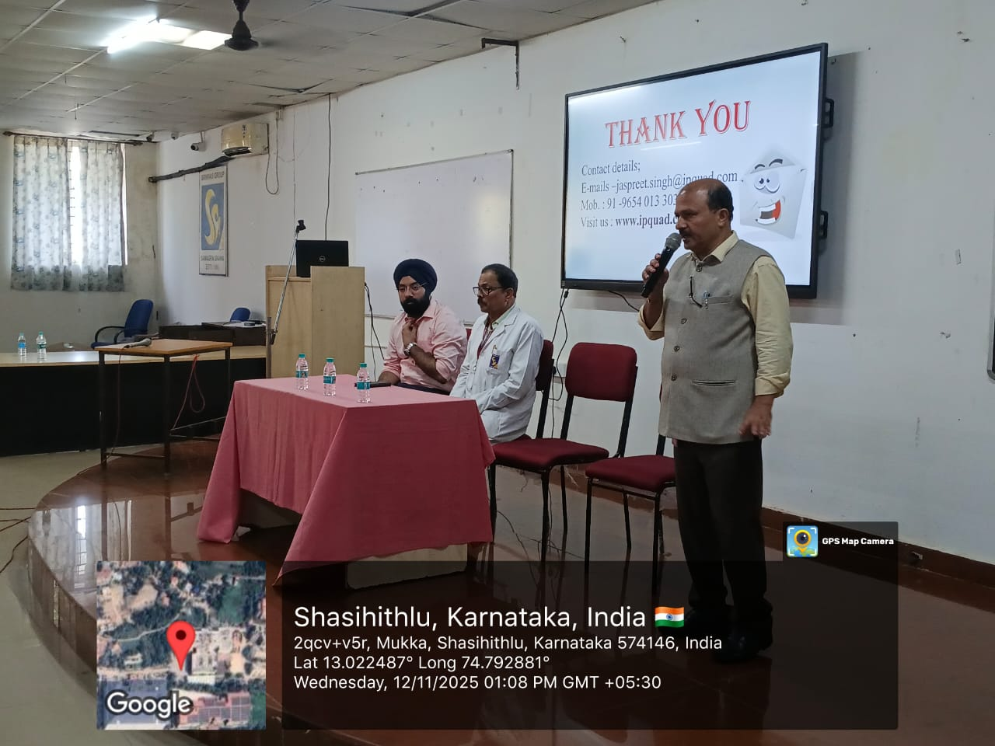
SRINIVAS INSTITUTE OF MEDICAL SCIENCES & RESEARCH CENTRE
SRINIVASNAGAR, MUKKA, MANGALORE – 574146. D.K
INTERACTION

Slide 5
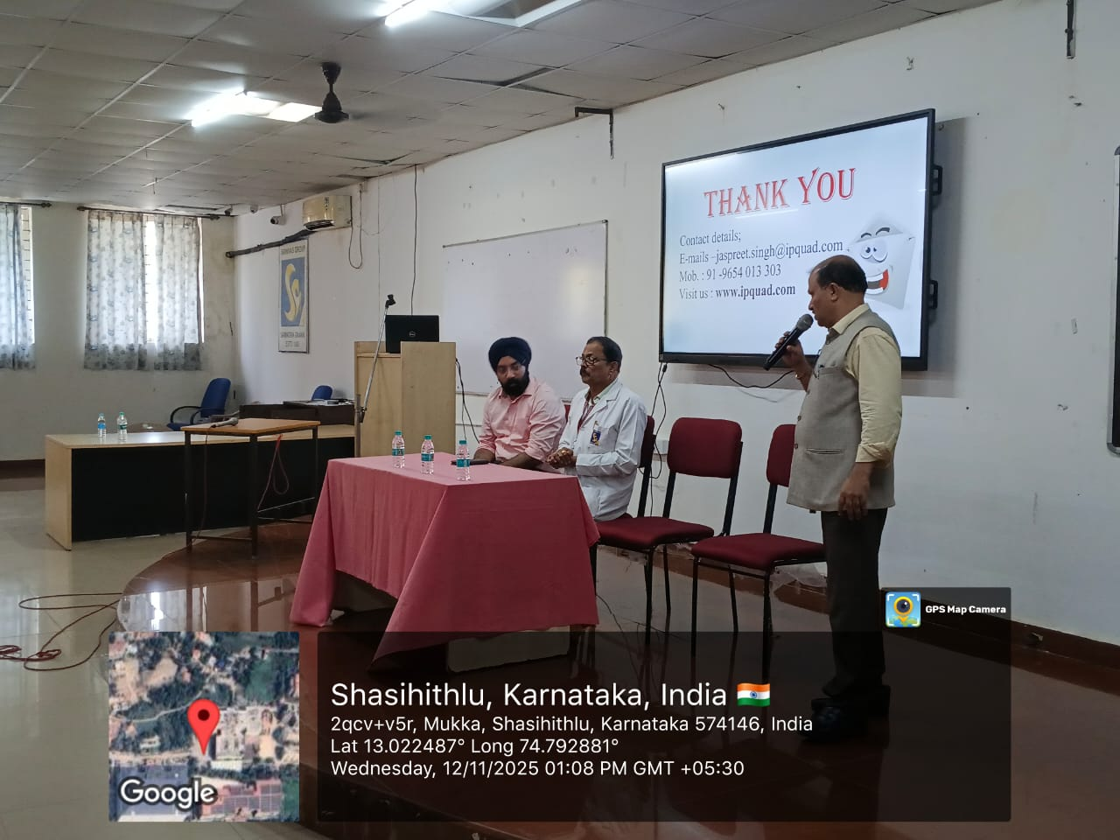
SRINIVAS INSTITUTE OF MEDICAL SCIENCES & RESEARCH CENTRE
SRINIVASNAGAR, MUKKA, MANGALORE – 574146. D.K
VOTE OF THANKS

