Slide 1


SRINIVAS INSTITUTE OF MEDICAL SCIENCES & RESEARCH CENTRE
SRINIVASNAGAR, MUKKA, MANGALORE – 574146. D.K
11th World Academic Congress of
Emergency Medicine
FUND EM –GRANT WRITING WORKSHOP
29th October 2025

Slide 2
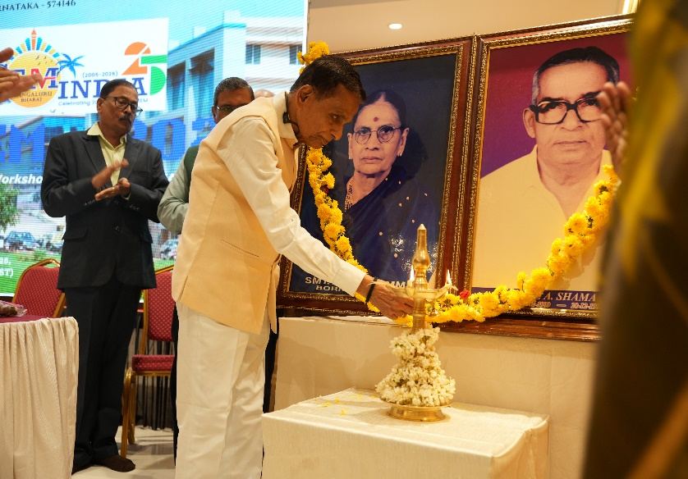
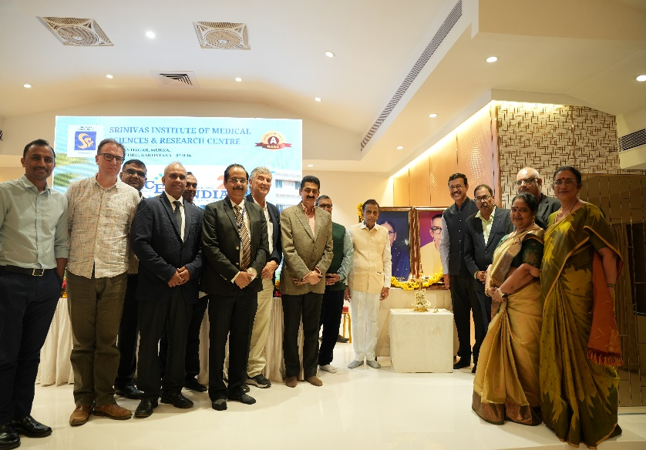
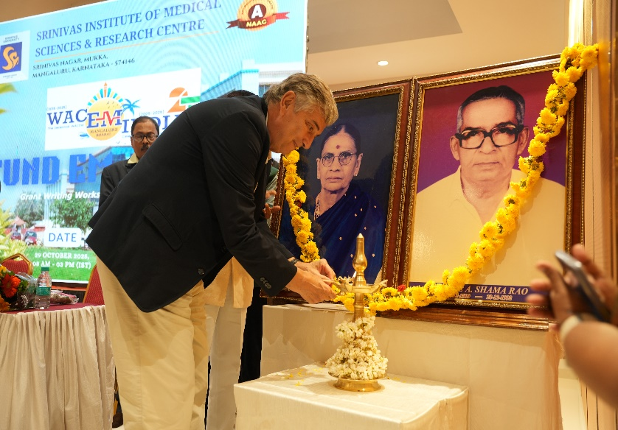
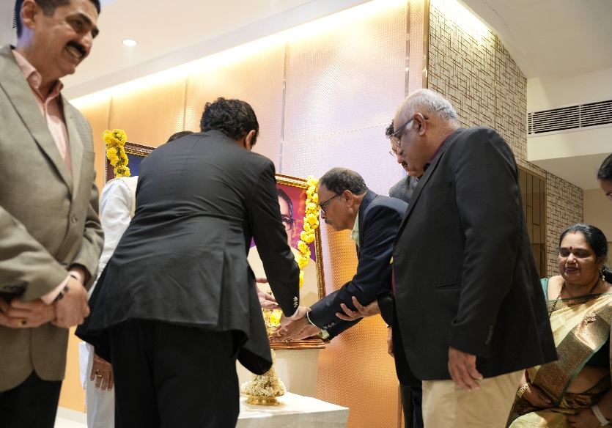
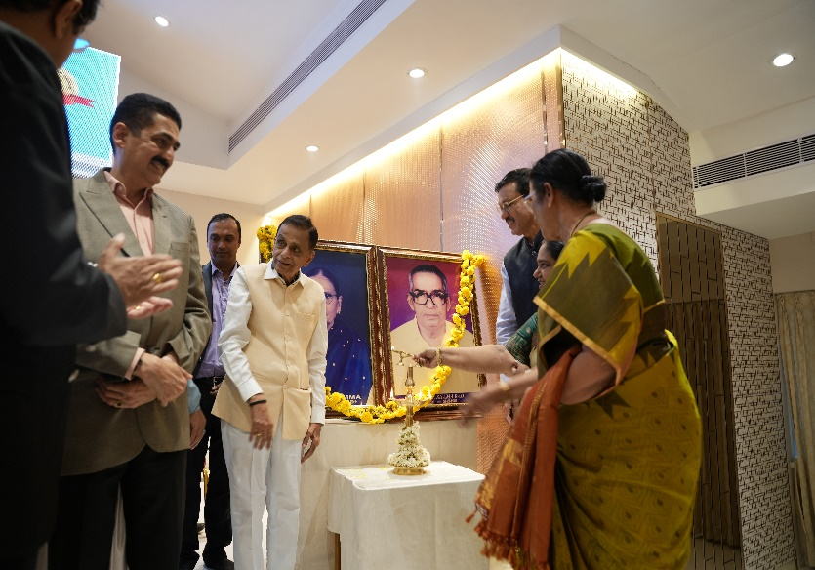
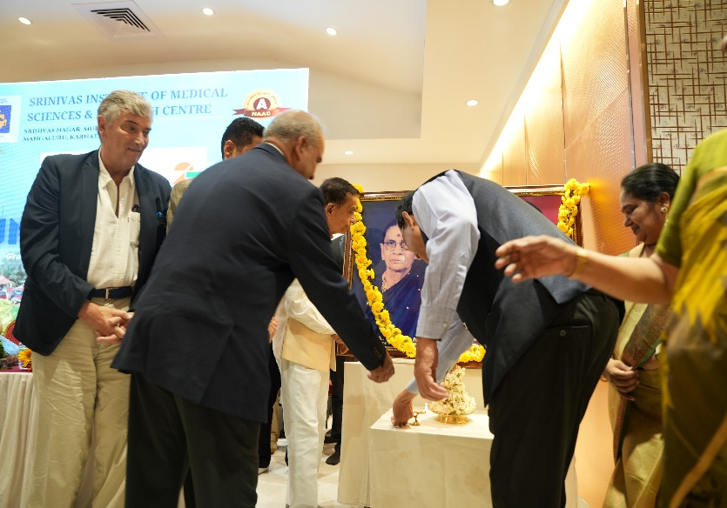
SRINIVAS INSTITUTE OF MEDICAL SCIENCES & RESEARCH CENTRE
SRINIVASNAGAR, MUKKA, MANGALORE – 574146. D.K
INAUGURAL CEREMONY

Slide 3
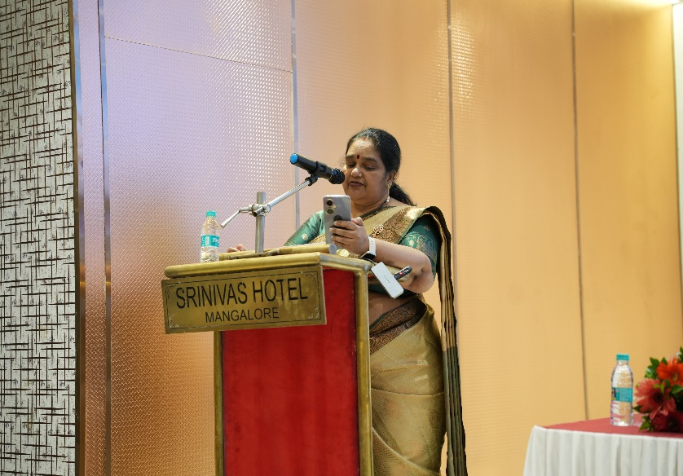
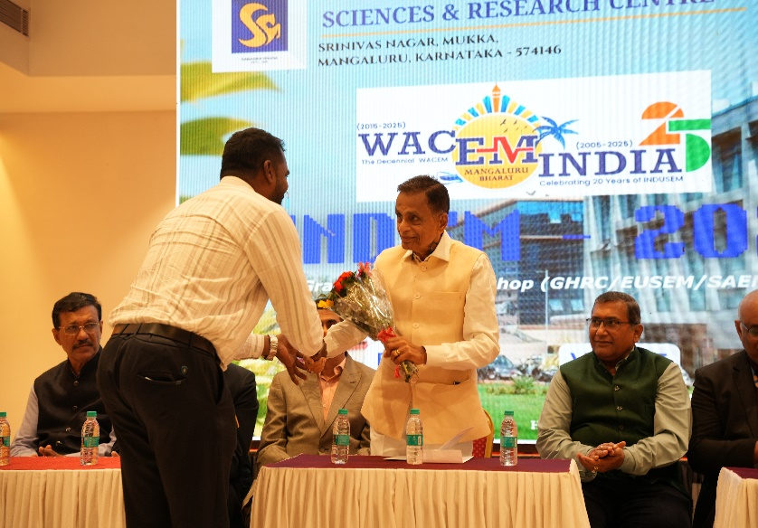
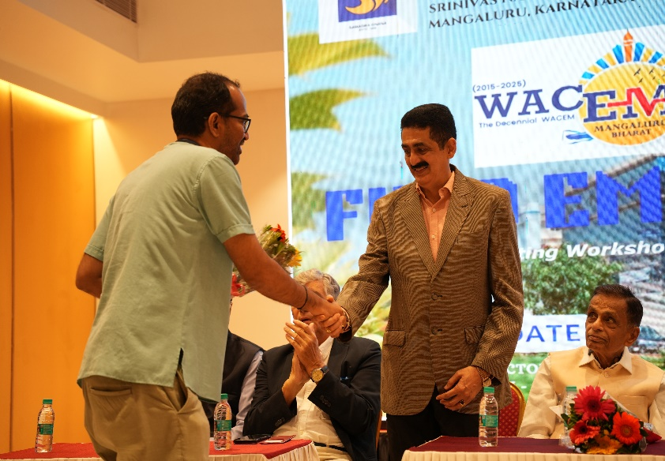
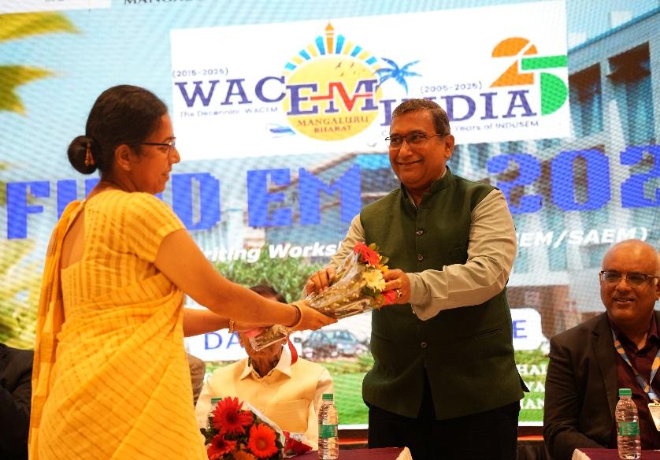
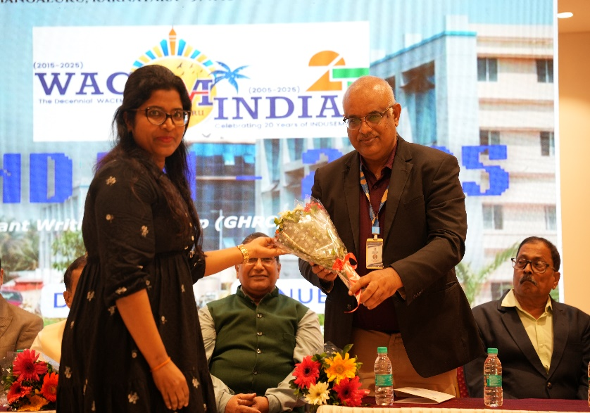
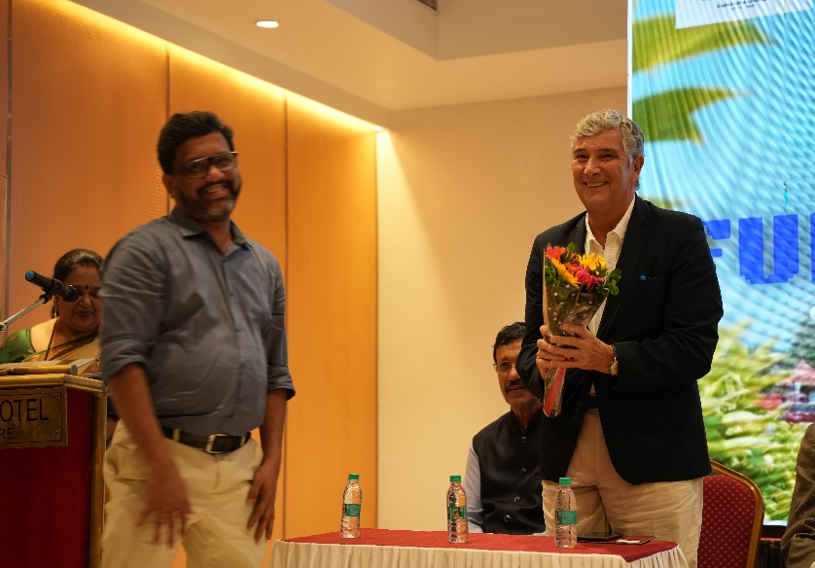
SRINIVAS INSTITUTE OF MEDICAL SCIENCES & RESEARCH CENTRE
SRINIVASNAGAR, MUKKA, MANGALORE – 574146. D.K
PREFACE & WELCOMING OF GUESTS

Slide 4
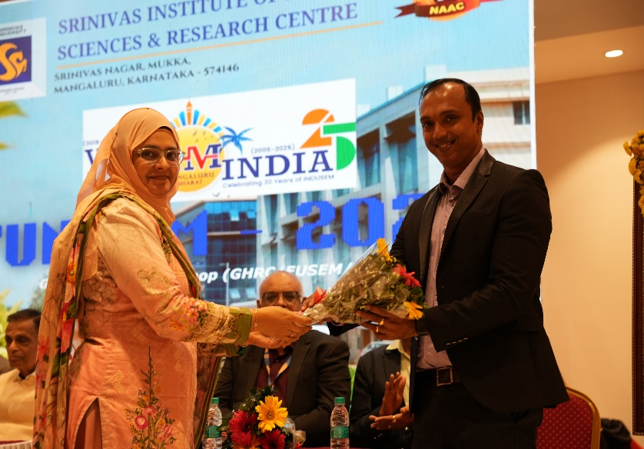
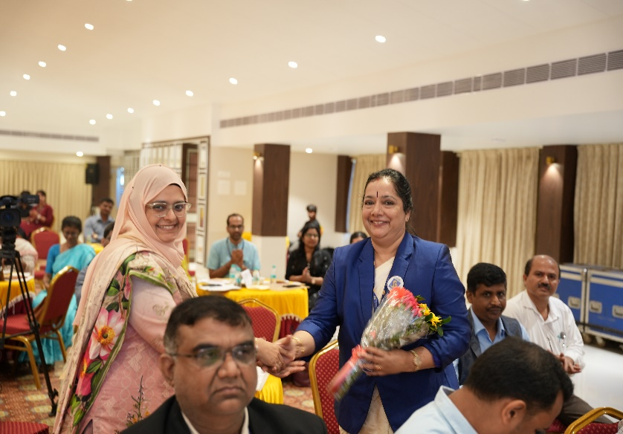
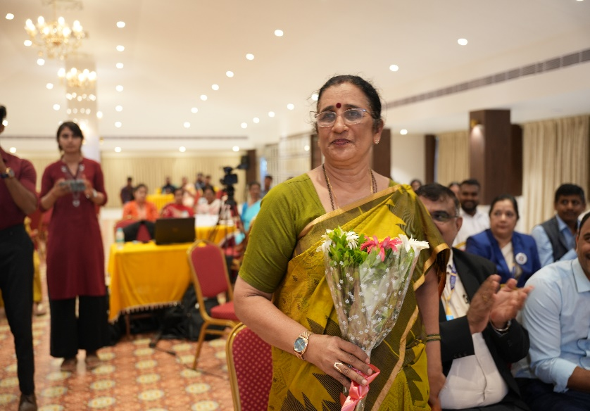
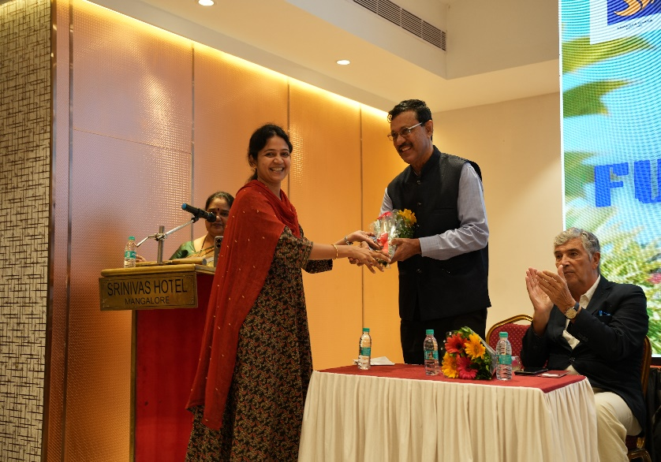
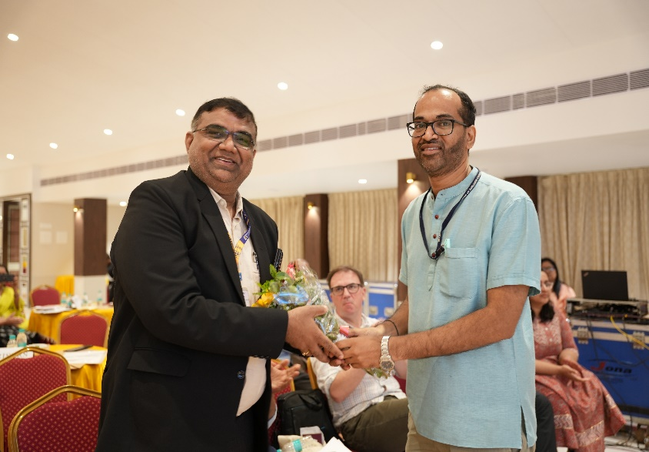
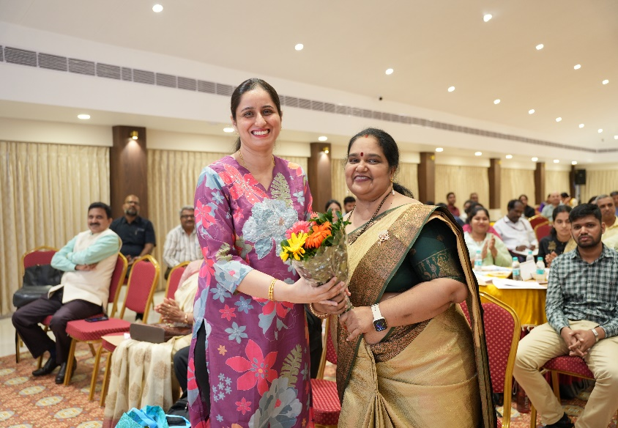
SRINIVAS INSTITUTE OF MEDICAL SCIENCES & RESEARCH CENTRE
SRINIVASNAGAR, MUKKA, MANGALORE – 574146. D.K
PREFACE & WELCOMING OF GUESTS

Slide 5
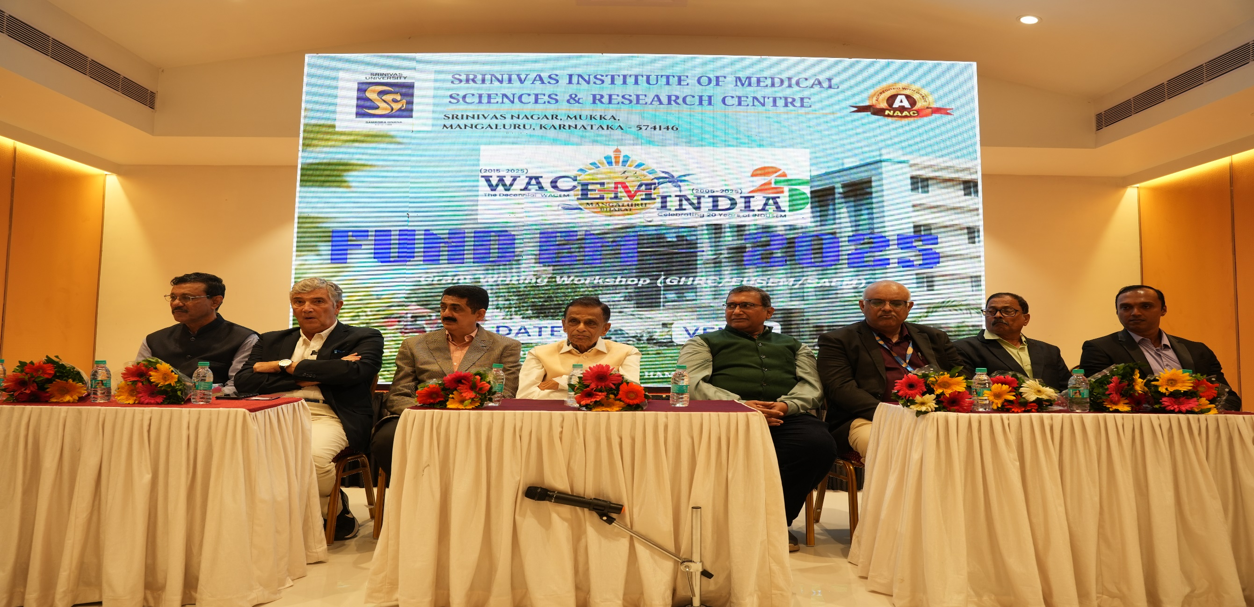
SRINIVAS INSTITUTE OF MEDICAL SCIENCES & RESEARCH CENTRE
SRINIVASNAGAR, MUKKA, MANGALORE – 574146. D.K
CHAIRMAN, CHIEF GUESTS & GUESTS OF HONOUIR

Slide 6
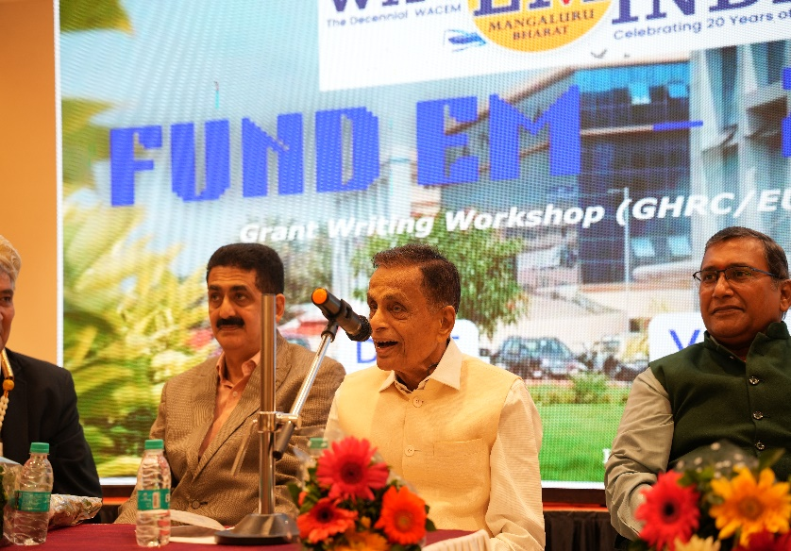
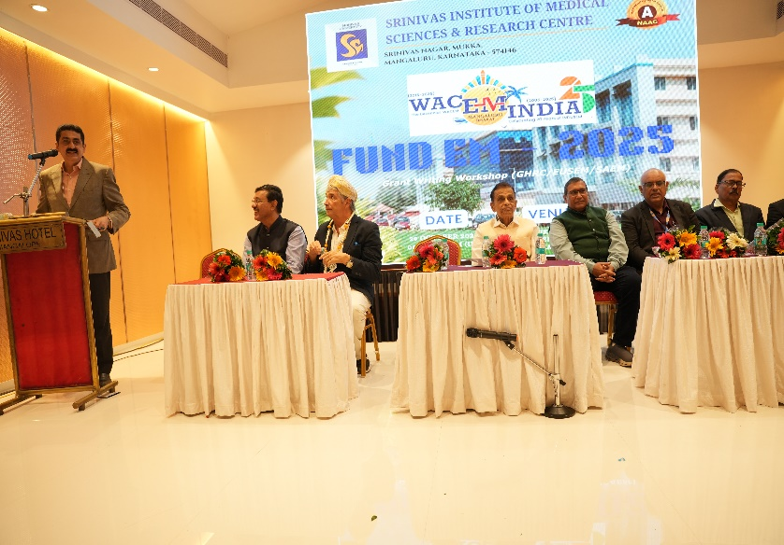
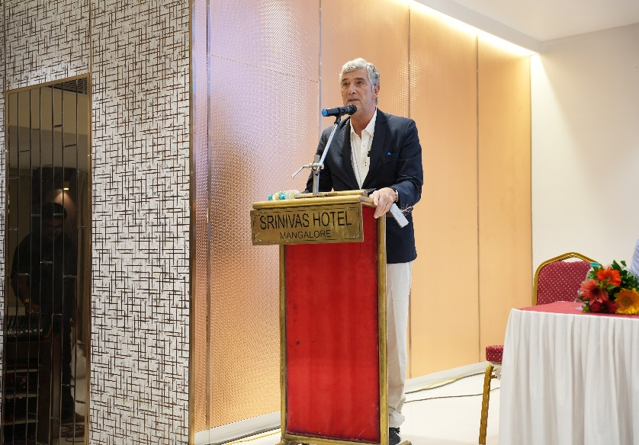
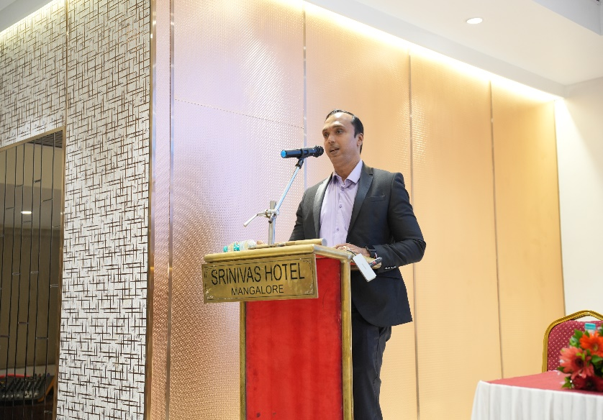
SRINIVAS INSTITUTE OF MEDICAL SCIENCES & RESEARCH CENTRE
SRINIVASNAGAR, MUKKA, MANGALORE – 574146. D.K
ADDRESS BY THE DIGNITORIES

Slide 7
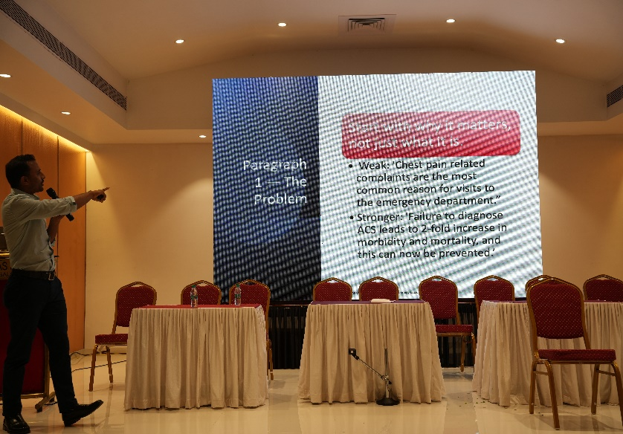
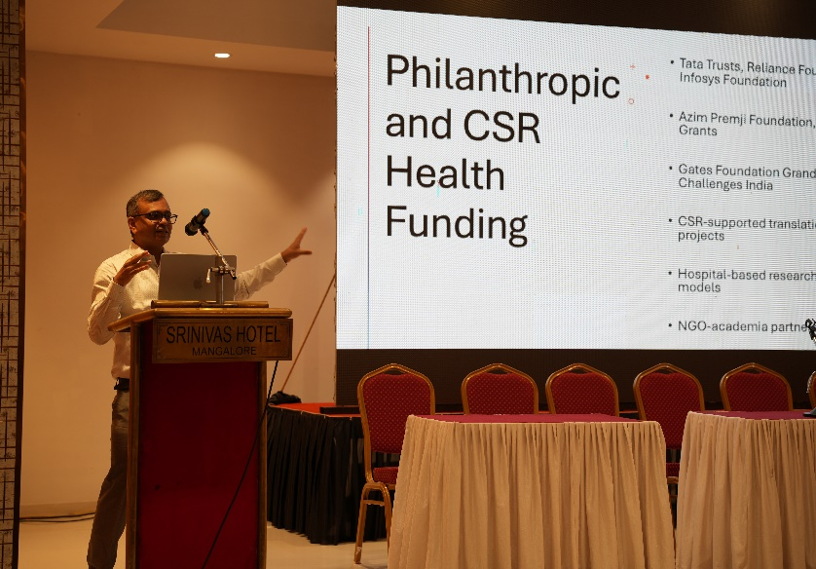
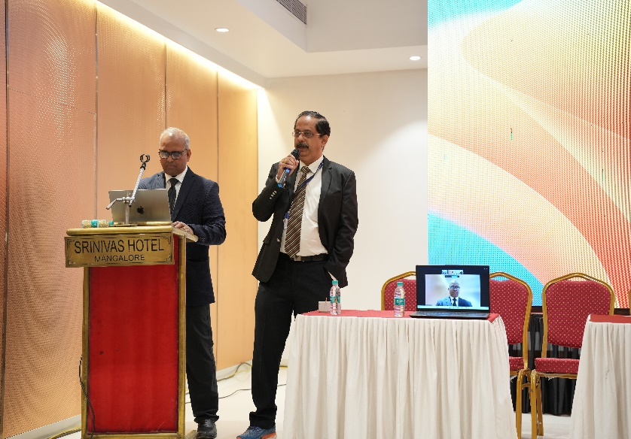
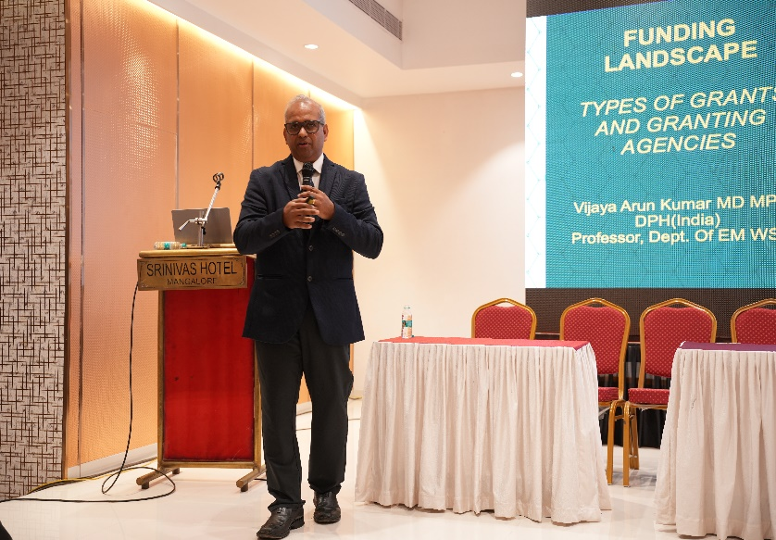
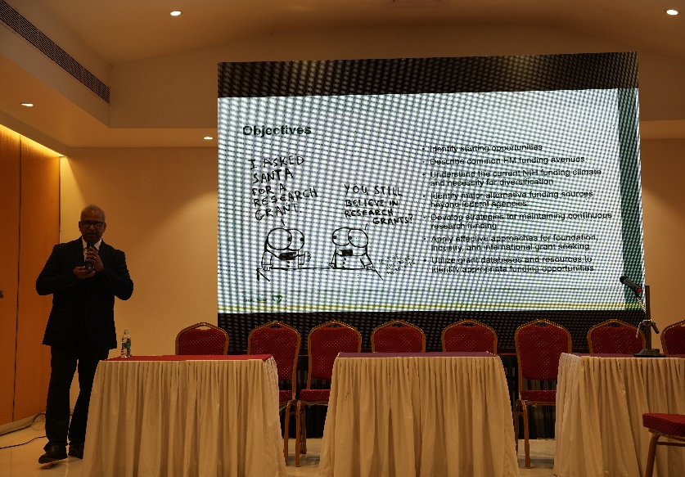
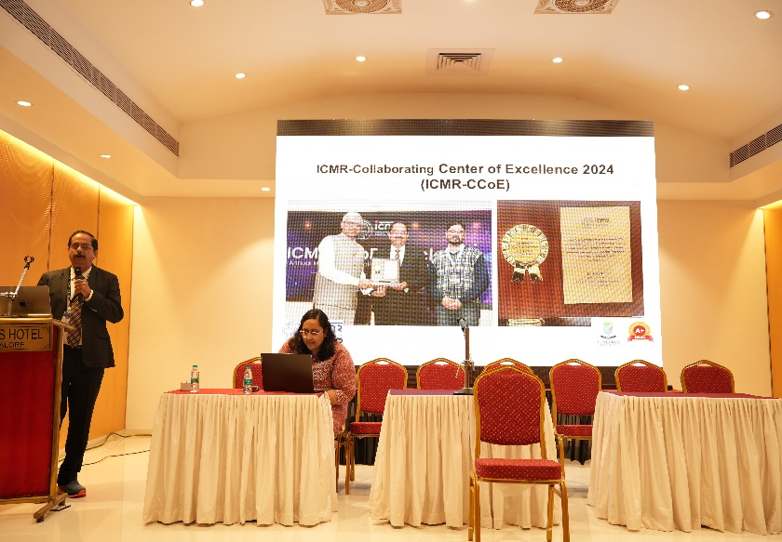
SRINIVAS INSTITUTE OF MEDICAL SCIENCES & RESEARCH CENTRE
SRINIVASNAGAR, MUKKA, MANGALORE – 574146. D.K
INSIGHTS OF FUND EM WORKSHOP

Slide 8
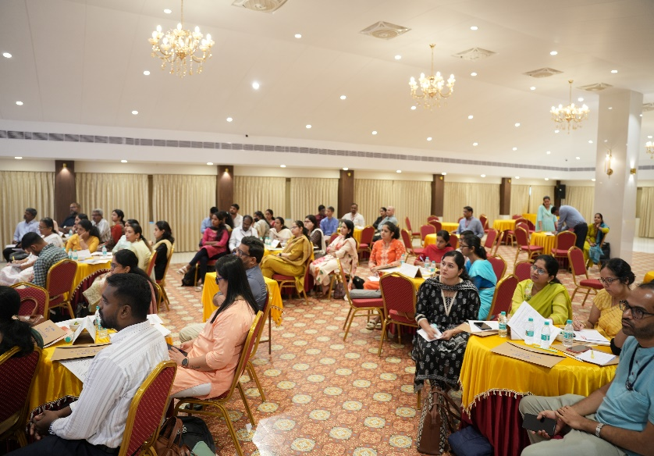
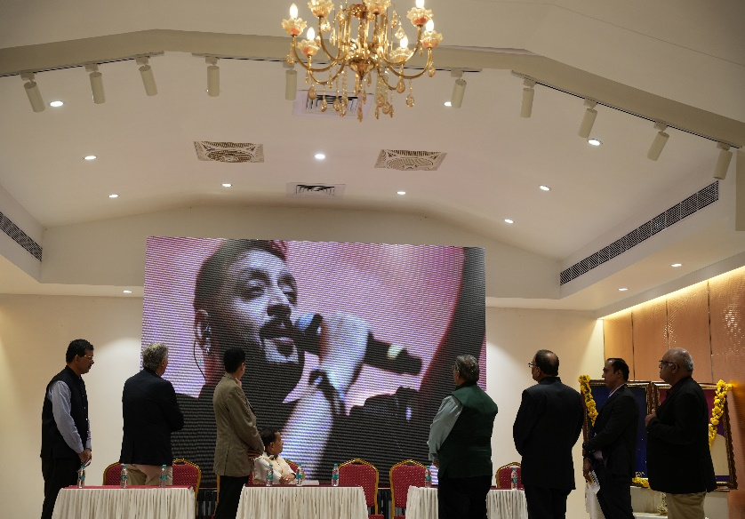
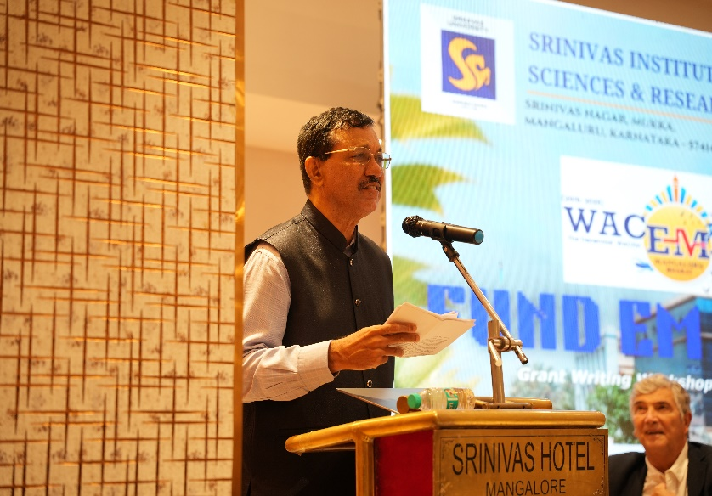
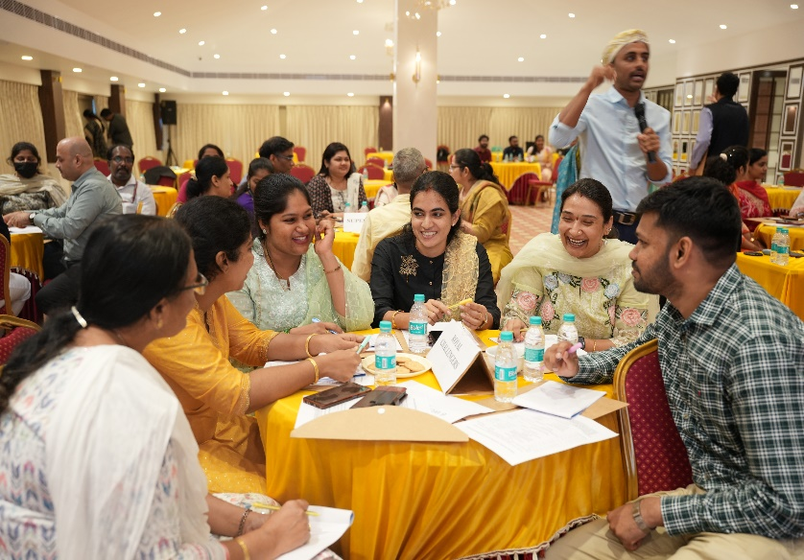
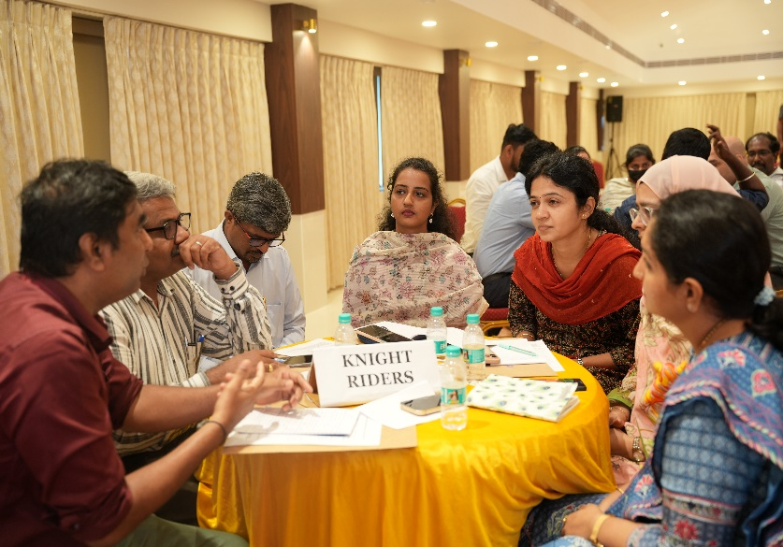
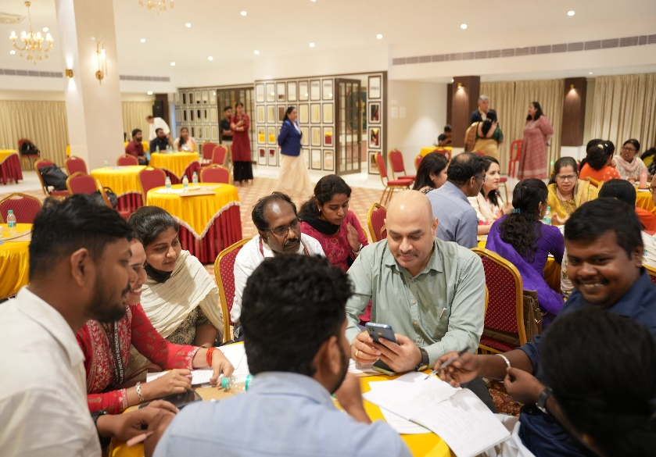
SRINIVAS INSTITUTE OF MEDICAL SCIENCES & RESEARCH CENTRE
SRINIVASNAGAR, MUKKA, MANGALORE – 574146. D.K
INSIGHTS OF FUND EM WORKSHOP

Slide 9
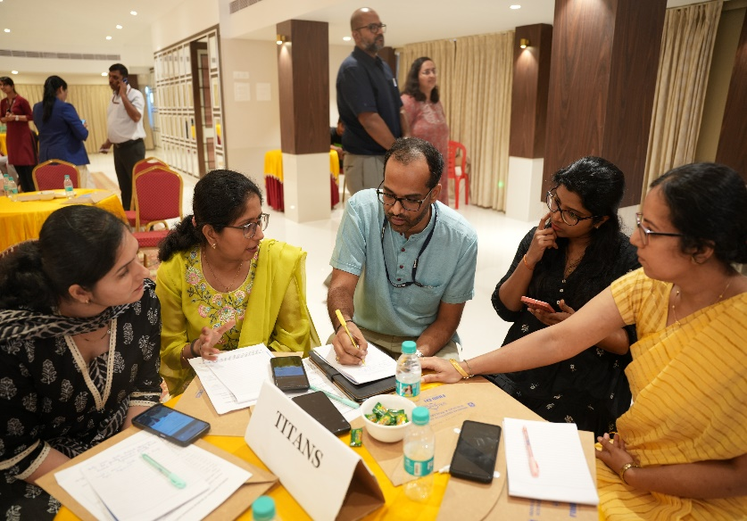
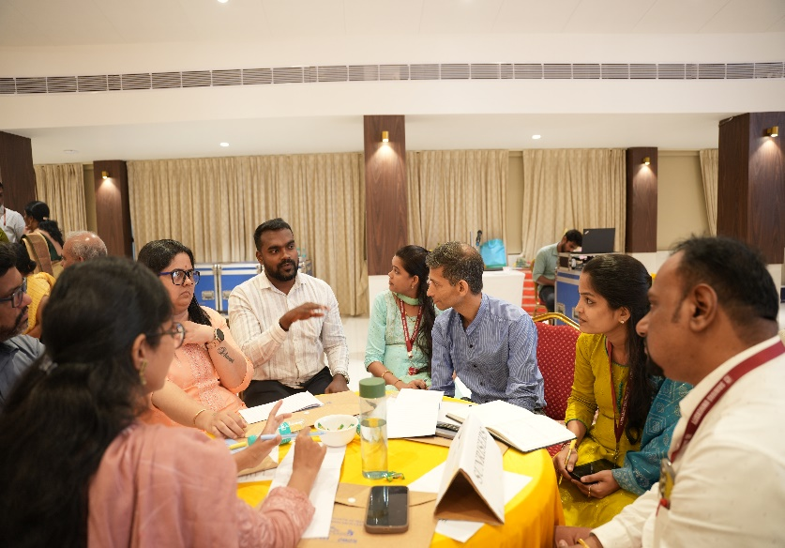
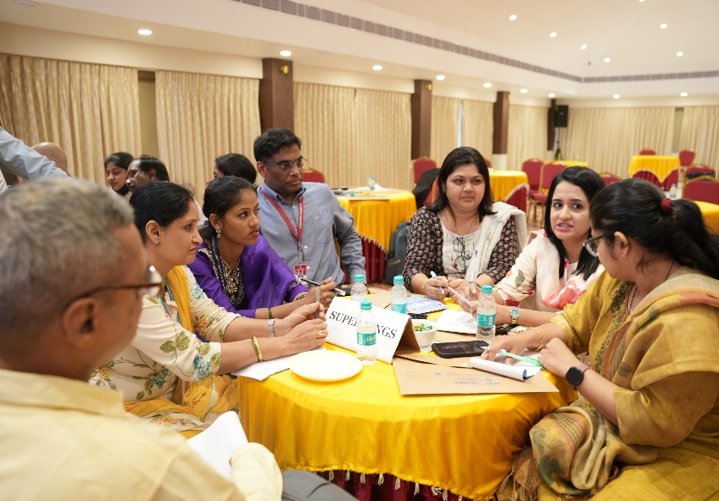
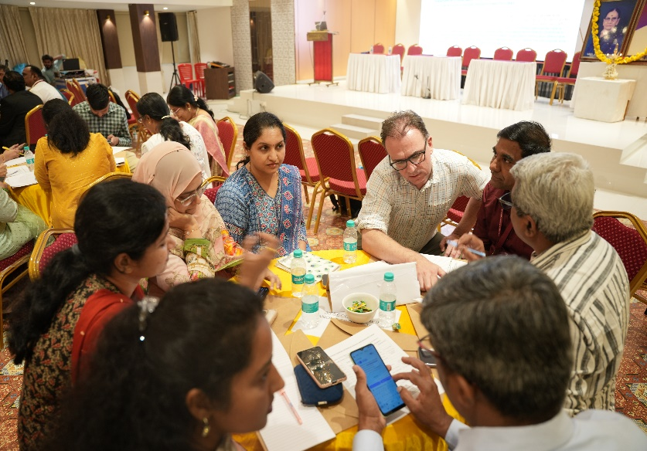
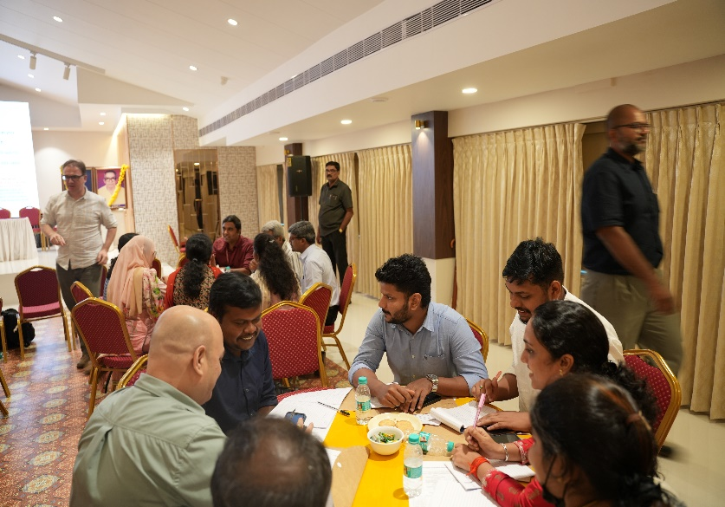
SRINIVAS INSTITUTE OF MEDICAL SCIENCES & RESEARCH CENTRE
SRINIVASNAGAR, MUKKA, MANGALORE – 574146. D.K
INSIGHTS OF FUND EM WORKSHOP

Slide 10
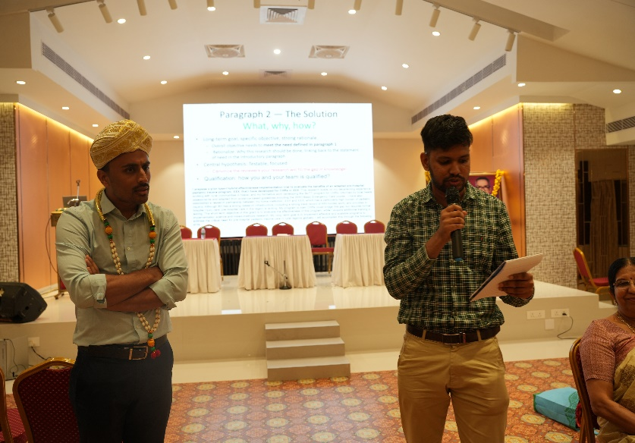
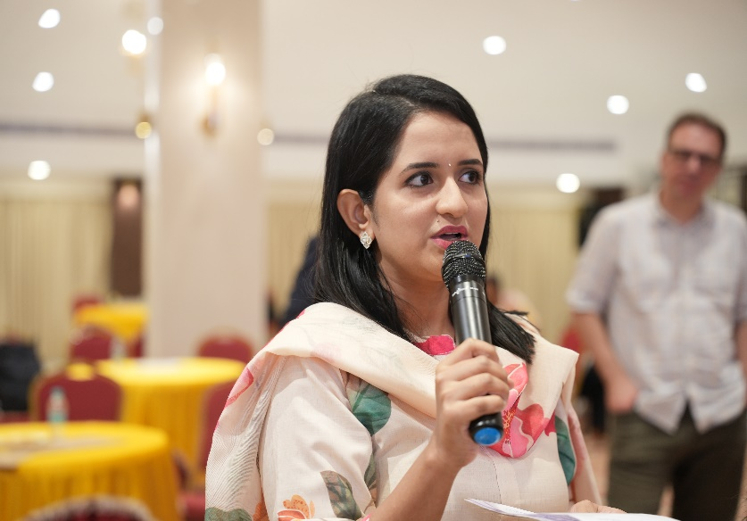
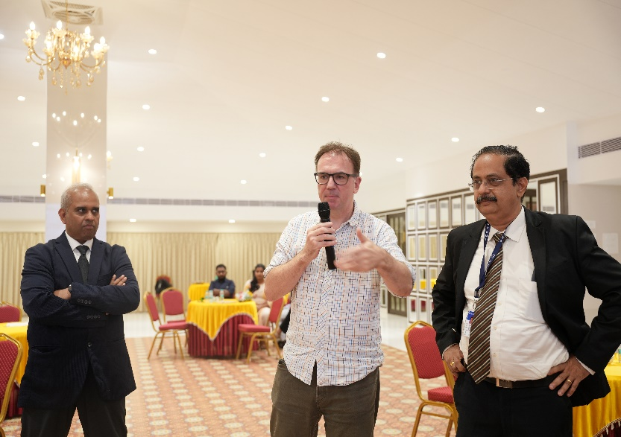
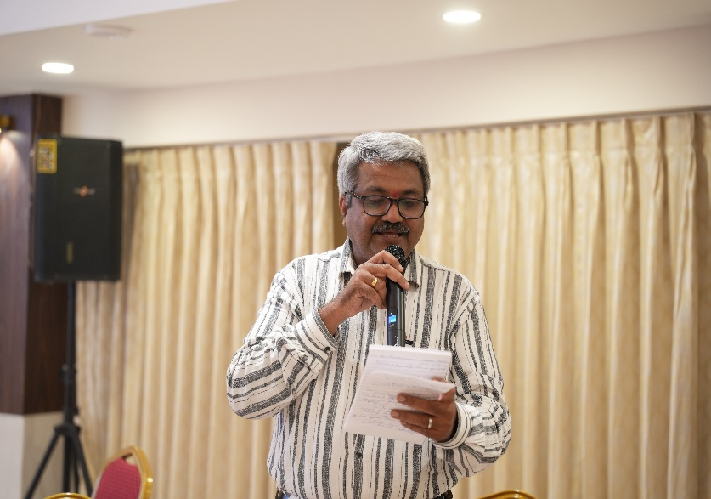
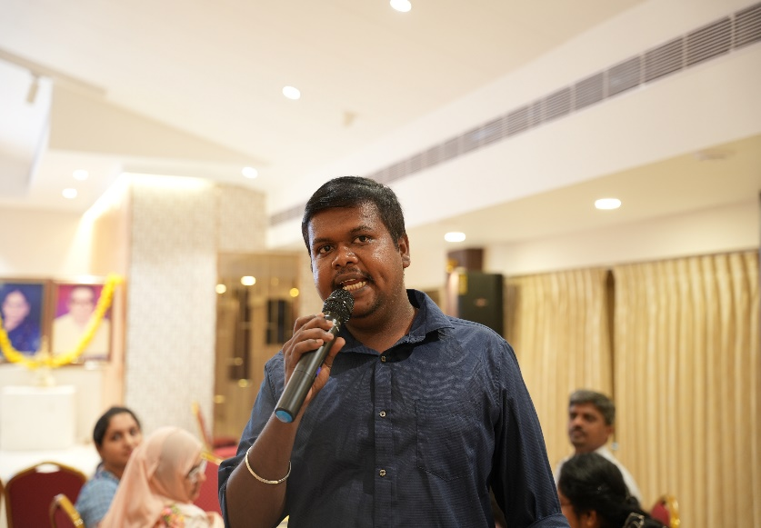
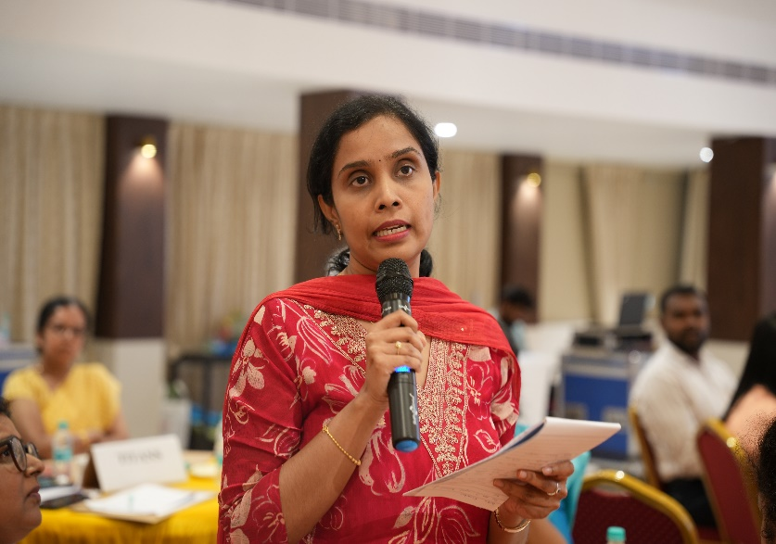
SRINIVAS INSTITUTE OF MEDICAL SCIENCES & RESEARCH CENTRE
SRINIVASNAGAR, MUKKA, MANGALORE – 574146. D.K
INSIGHTS OF FUND EM WORKSHOP

Slide 11
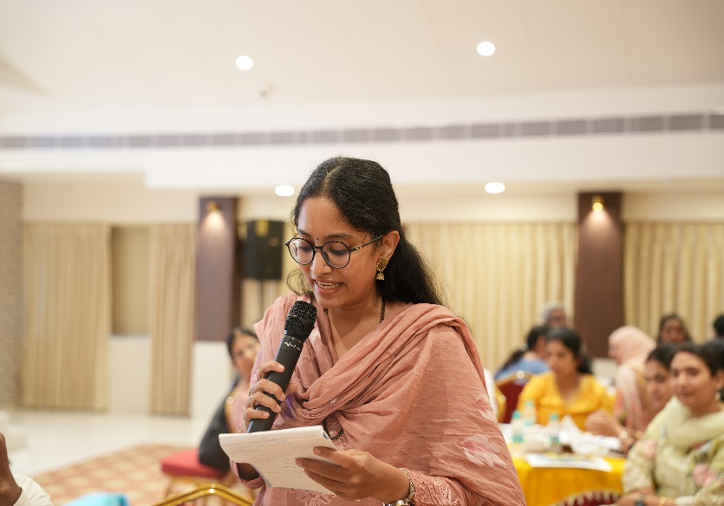
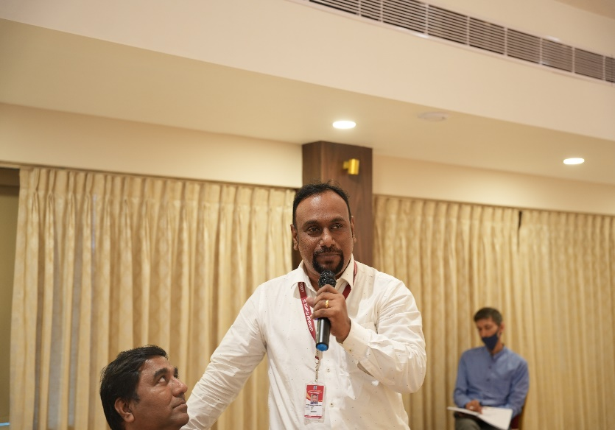
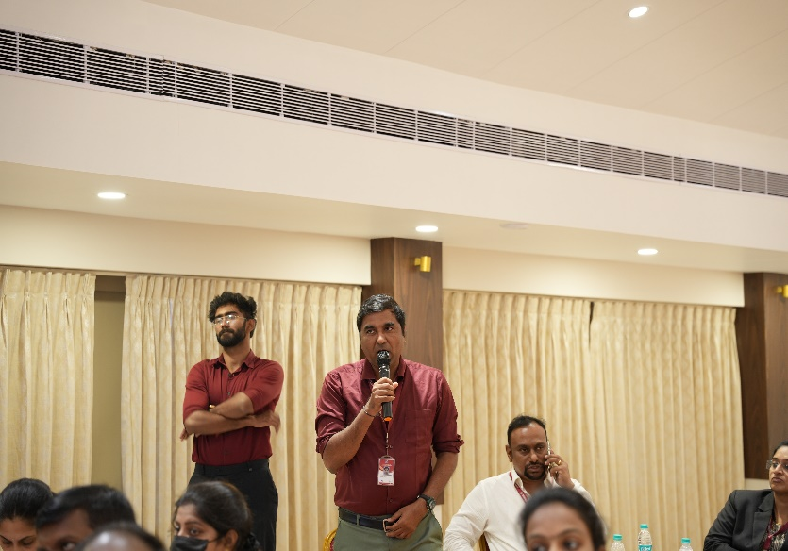
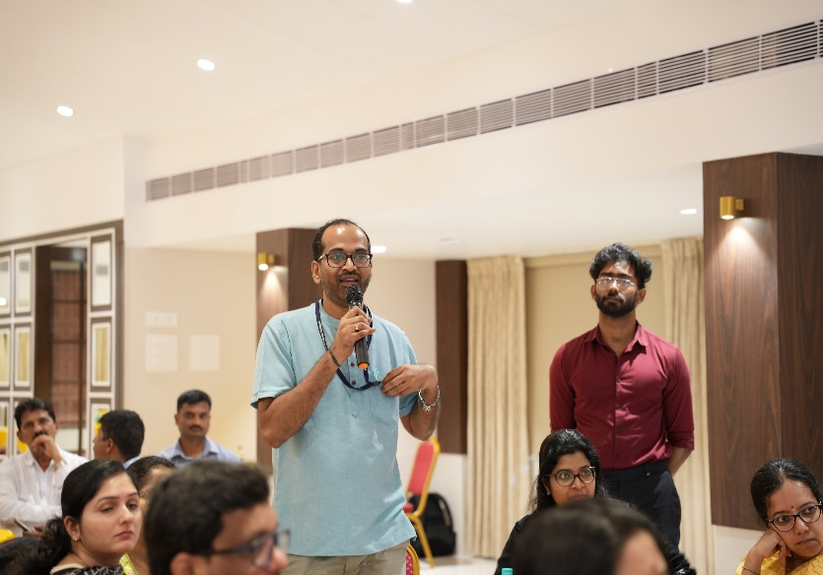


SRINIVAS INSTITUTE OF MEDICAL SCIENCES & RESEARCH CENTRE
SRINIVASNAGAR, MUKKA, MANGALORE – 574146. D.K
INSIGHTS OF FUND EM WORKSHOP

Slide 12






SRINIVAS INSTITUTE OF MEDICAL SCIENCES & RESEARCH CENTRE
SRINIVASNAGAR, MUKKA, MANGALORE – 574146. D.K
INSIGHTS OF FUND EM WORKSHOP

Slide 13

SRINIVAS INSTITUTE OF MEDICAL SCIENCES & RESEARCH CENTRE
SRINIVASNAGAR, MUKKA, MANGALORE – 574146. D.K
THANK YOU

