Slide 1


SRINIVAS INSTITUTE OF MEDICAL SCIENCES & RESEARCH CENTRE
SRINIVASNAGAR, MUKKA, MANGALORE – 574146. D.K
CHILDREN’S DAY CELEBRATIONS
DEPARTMENT OF PAEDIATRICS
Venue: SIMS & RC
Date: 14-11-2025

Slide 2
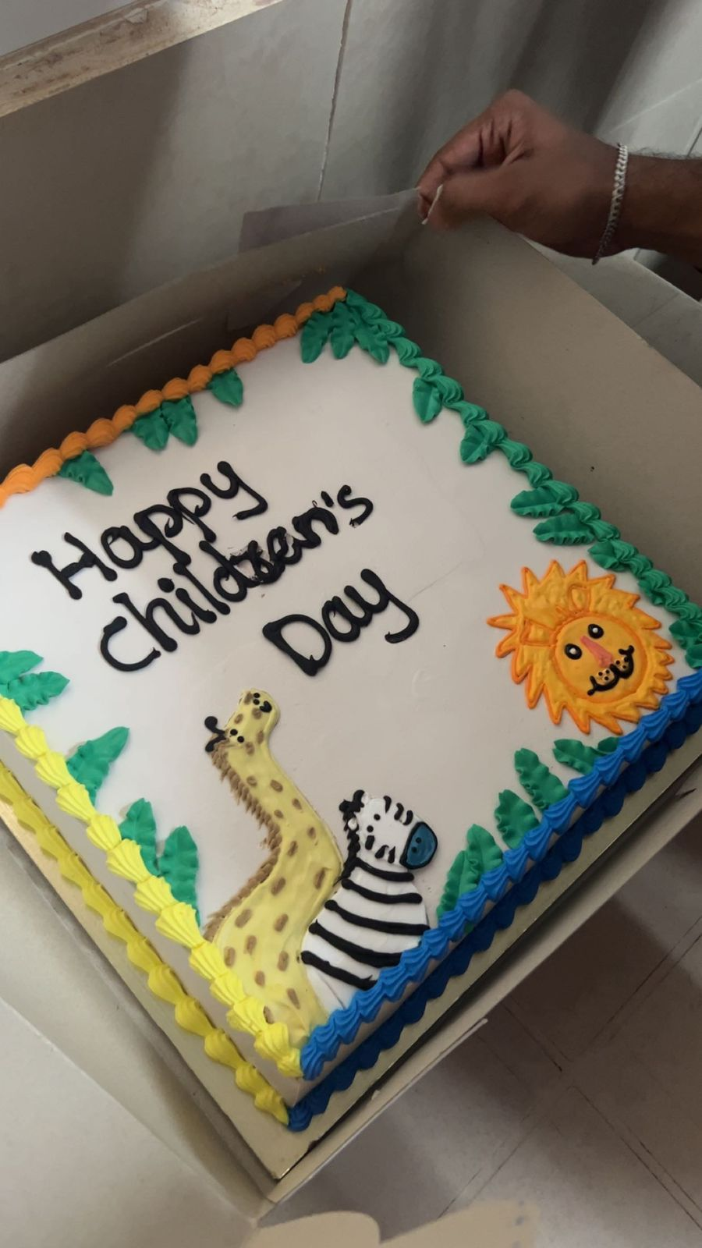
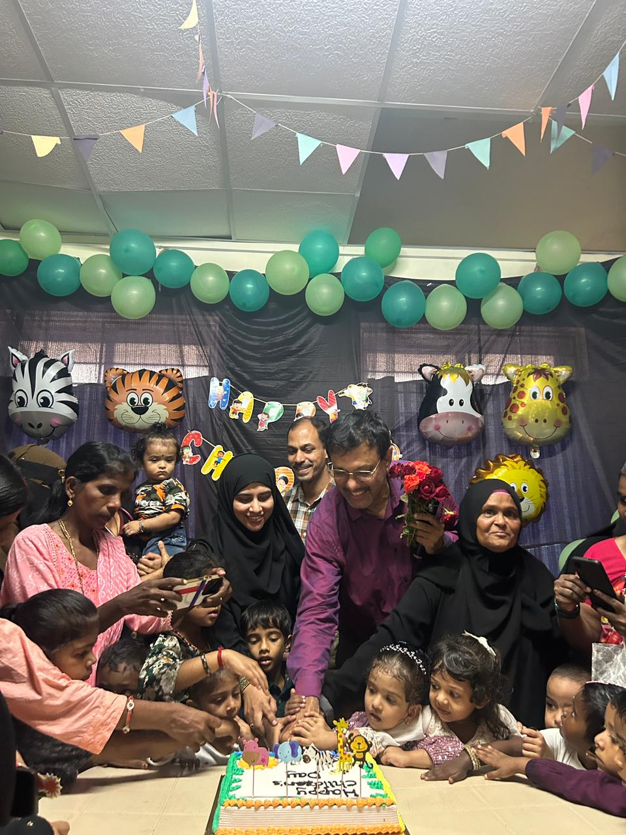
SRINIVAS INSTITUTE OF MEDICAL SCIENCES & RESEARCH CENTRE
SRINIVASNAGAR, MUKKA, MANGALORE – 574146. D.K
INAUGURAL CEREMONY

Slide 3
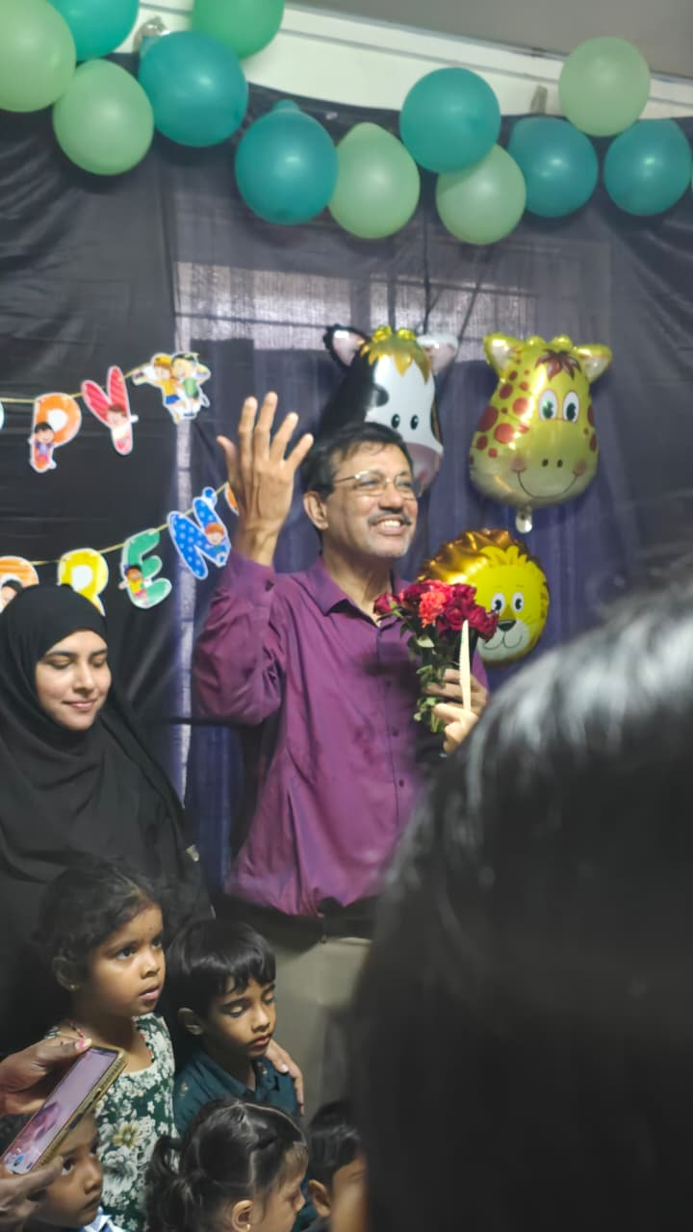
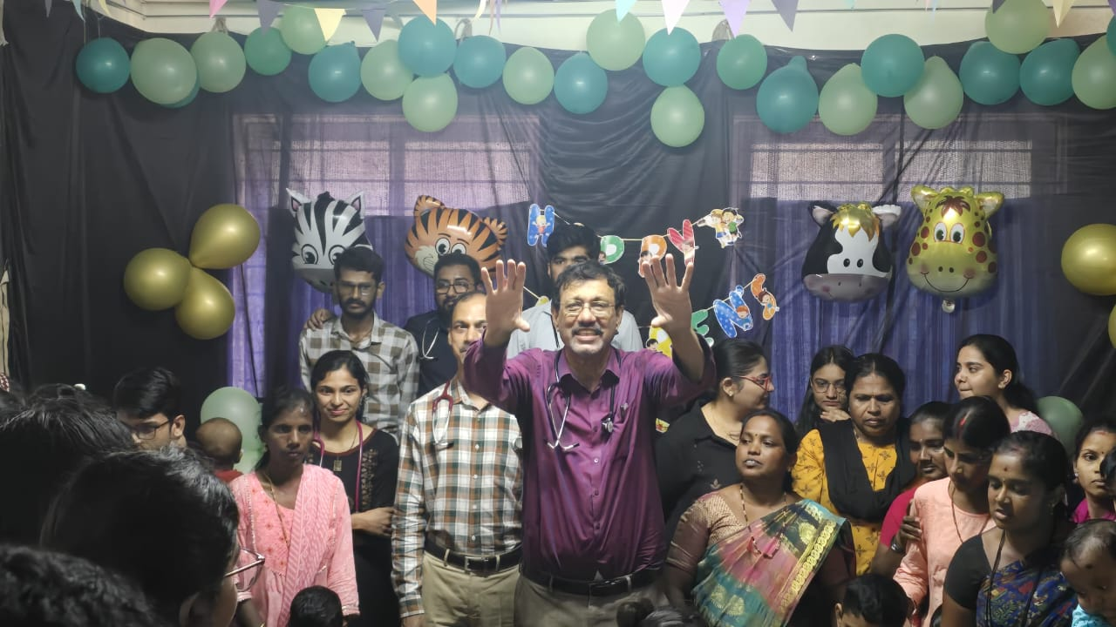
SRINIVAS INSTITUTE OF MEDICAL SCIENCES & RESEARCH CENTRE
SRINIVASNAGAR, MUKKA, MANGALORE – 574146. D.K
FUN & FROLIC

Slide 4
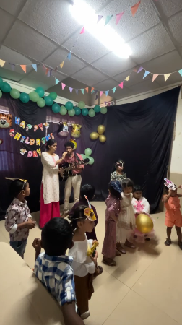
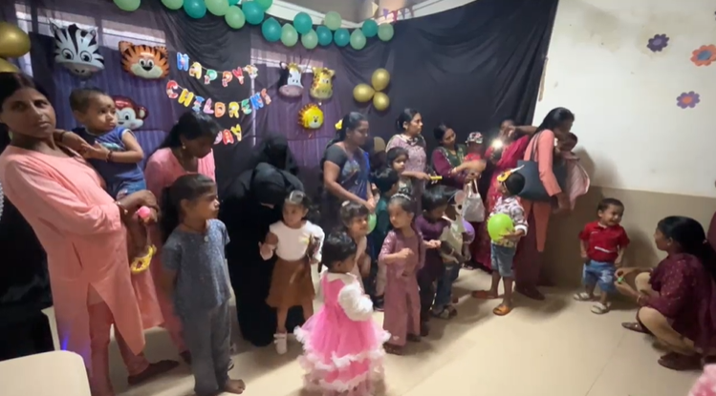
SRINIVAS INSTITUTE OF MEDICAL SCIENCES & RESEARCH CENTRE
SRINIVASNAGAR, MUKKA, MANGALORE – 574146. D.K
FUN & FROLIC

Slide 5
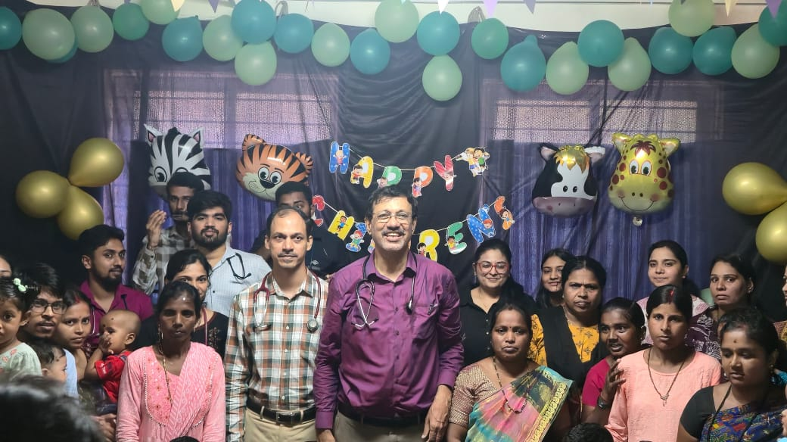
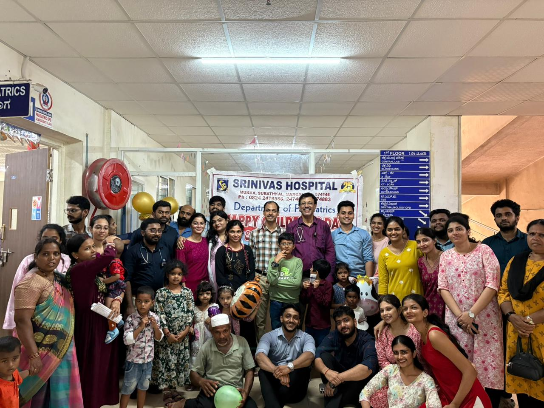
SRINIVAS INSTITUTE OF MEDICAL SCIENCES & RESEARCH CENTRE
SRINIVASNAGAR, MUKKA, MANGALORE – 574146. D.K
FUN & FROLIC

Slide 6
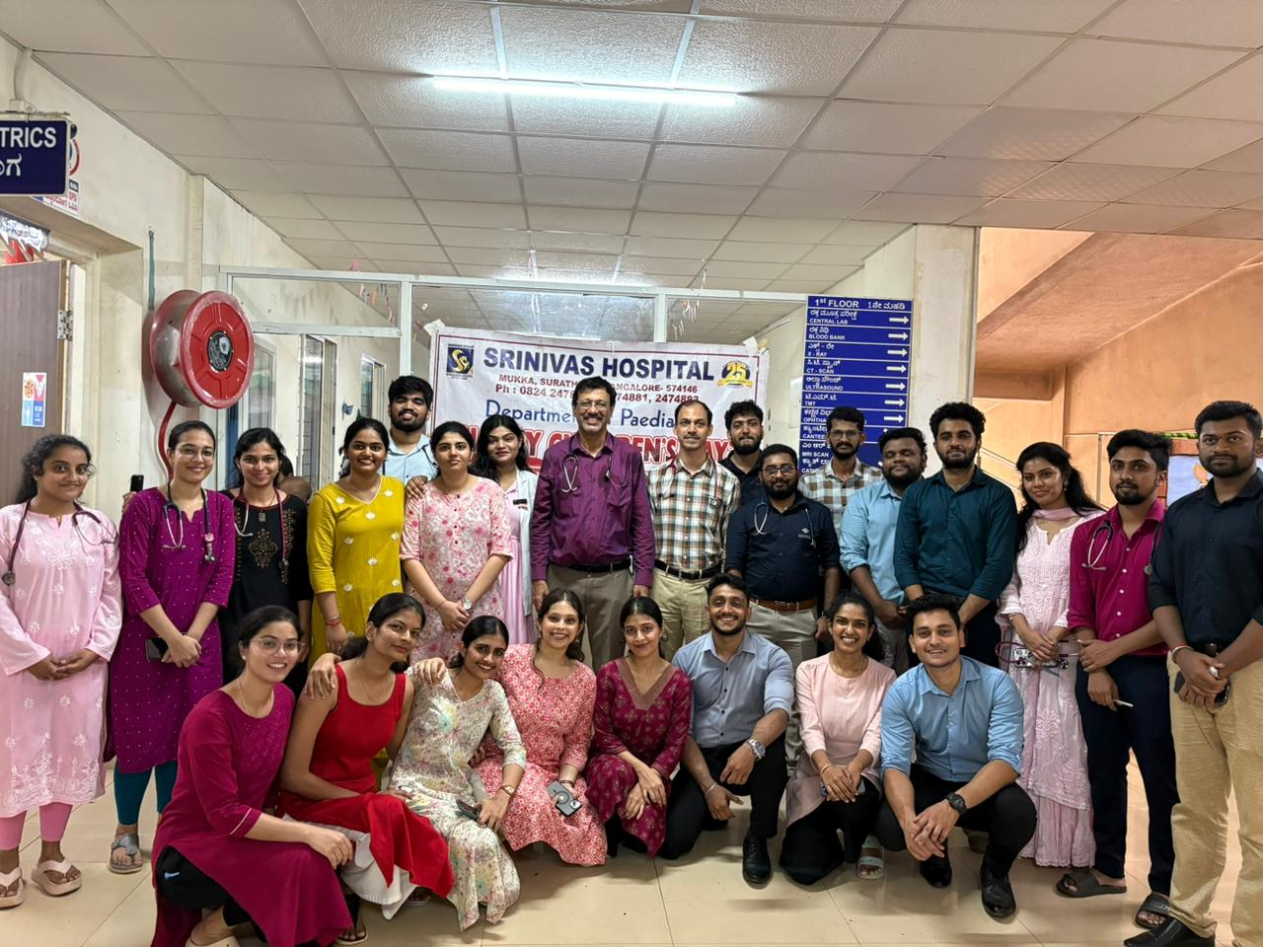
SRINIVAS INSTITUTE OF MEDICAL SCIENCES & RESEARCH CENTRE
SRINIVASNAGAR, MUKKA, MANGALORE – 574146. D.K
PAEDIATRIC TEAM

