Slide 1


SRINIVAS INSTITUTE OF MEDICAL SCIENCES & RESEARCH CENTRE
SRINIVASNAGAR, MUKKA, MANGALORE – 574146. D.K
CME of
DEPARTMENT OF ORTHOPAEDICS, SIMS & RC in Collaboration with
CANARA ORTHOPAEDIC SOCIETY® on
COMPREHENSIVE REVIEW OF FOOT AND ANKLE DISORDER
Date: 22nd November 2025
Venue: Vaikunta Hall, Srinivas Hotel

Slide 2
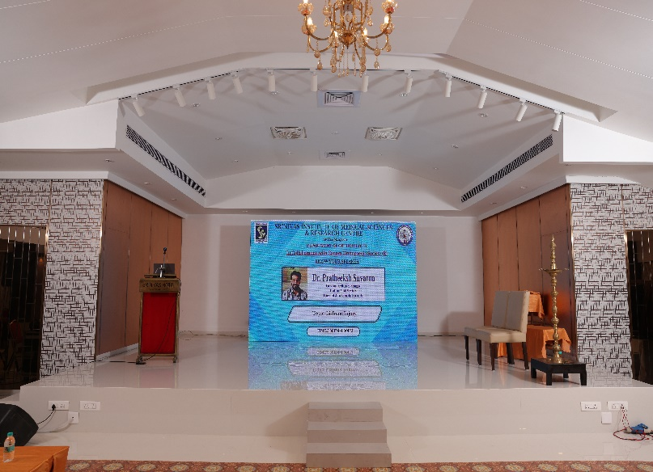
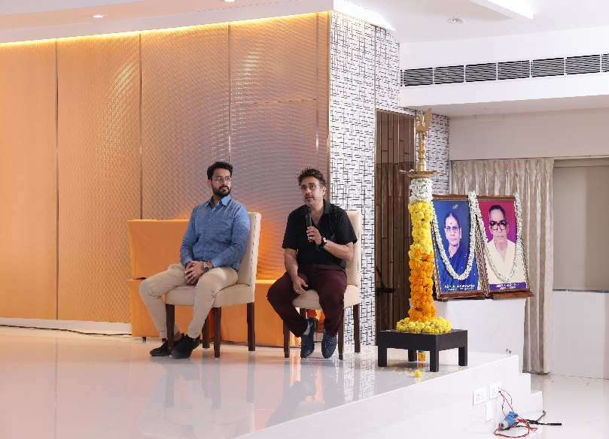
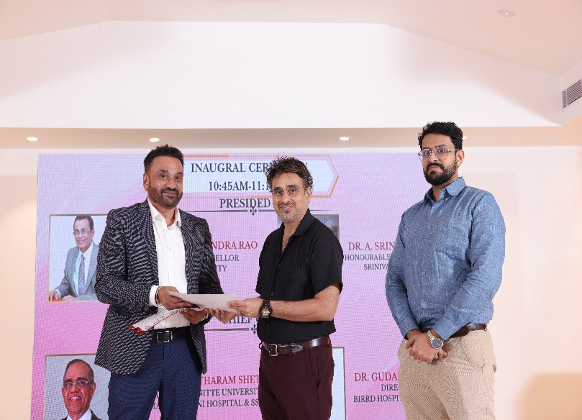
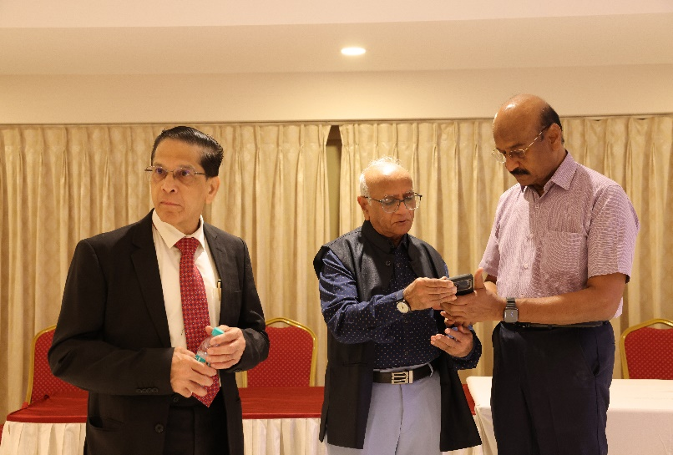
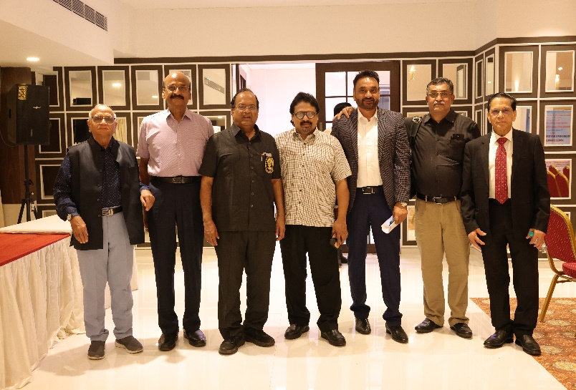
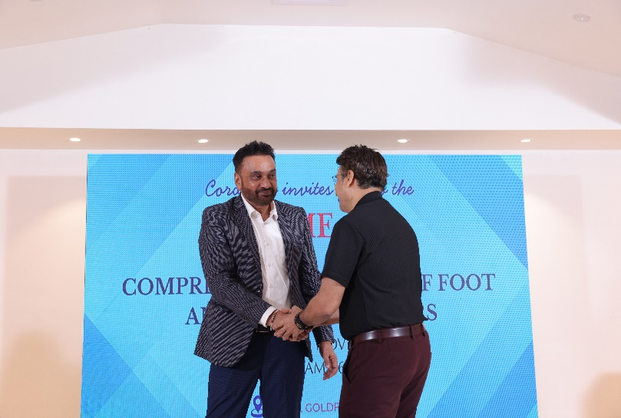
SRINIVAS INSTITUTE OF MEDICAL SCIENCES & RESEARCH CENTRE
SRINIVASNAGAR, MUKKA, MANGALORE – 574146. D.K
INAUGURAL FUNCTION & KNOW YOUR SPEAKER

Slide 3
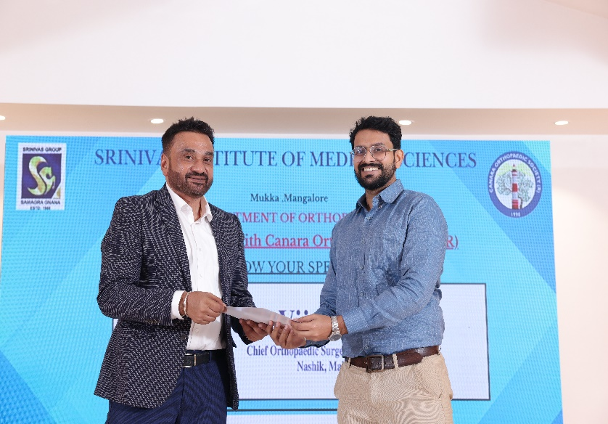
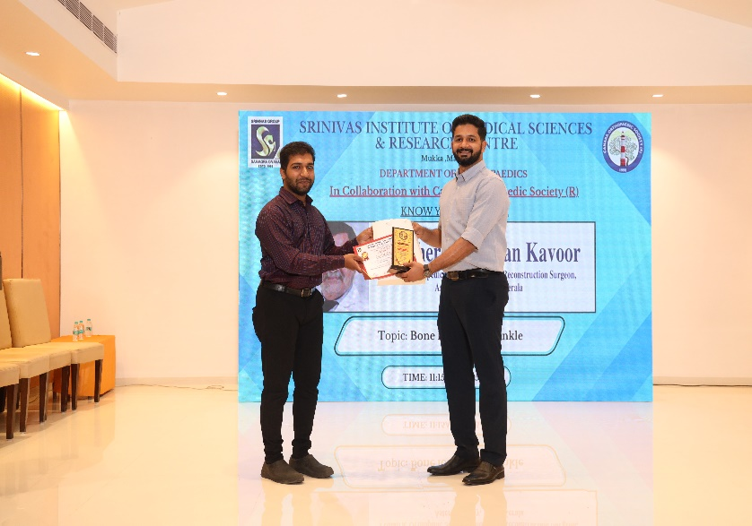
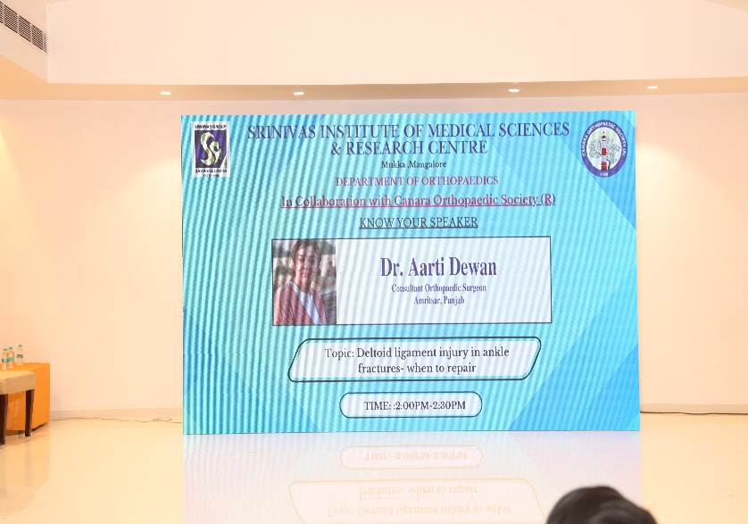
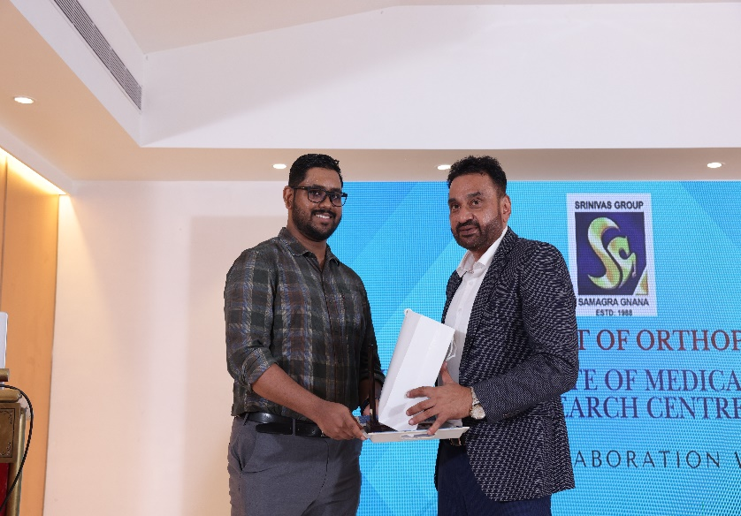
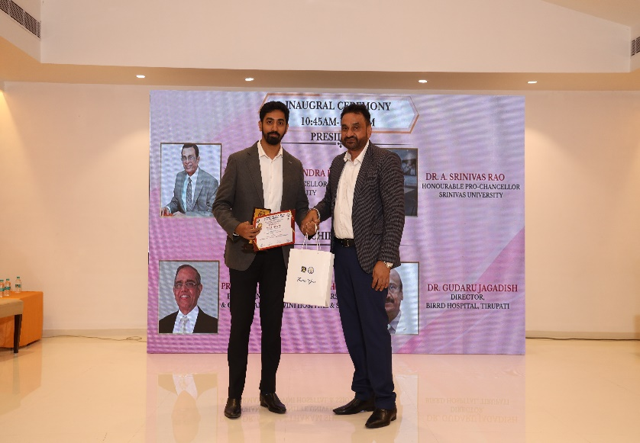
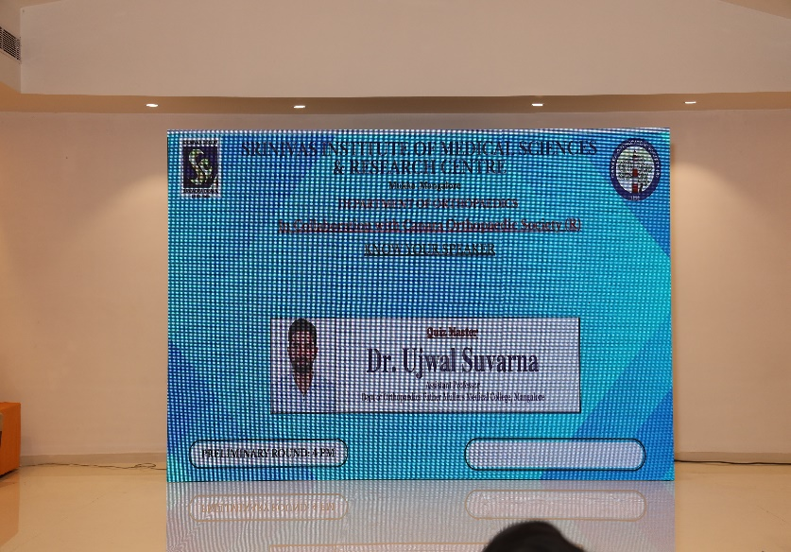
SRINIVAS INSTITUTE OF MEDICAL SCIENCES & RESEARCH CENTRE
SRINIVASNAGAR, MUKKA, MANGALORE – 574146. D.K
KNOW YOUR SPEAKER

Slide 4
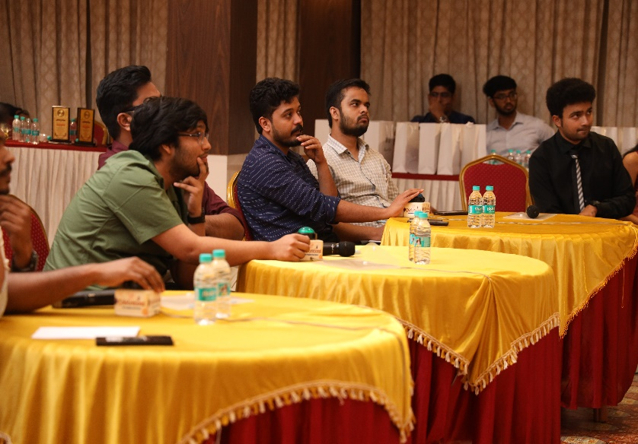
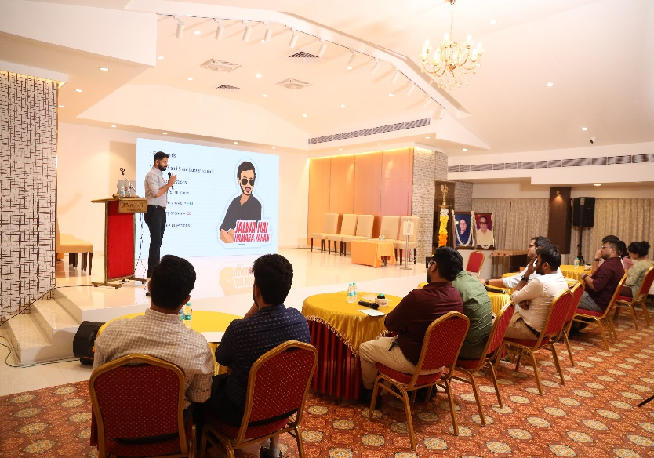
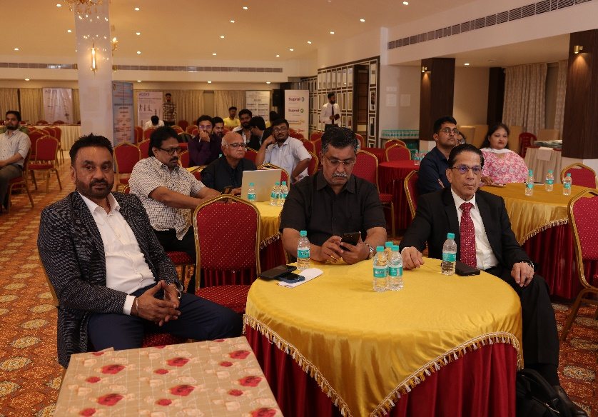
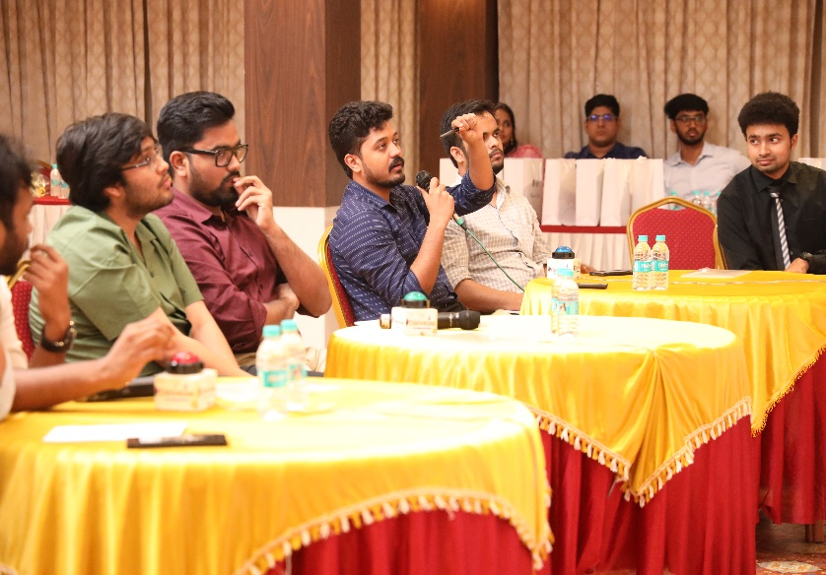
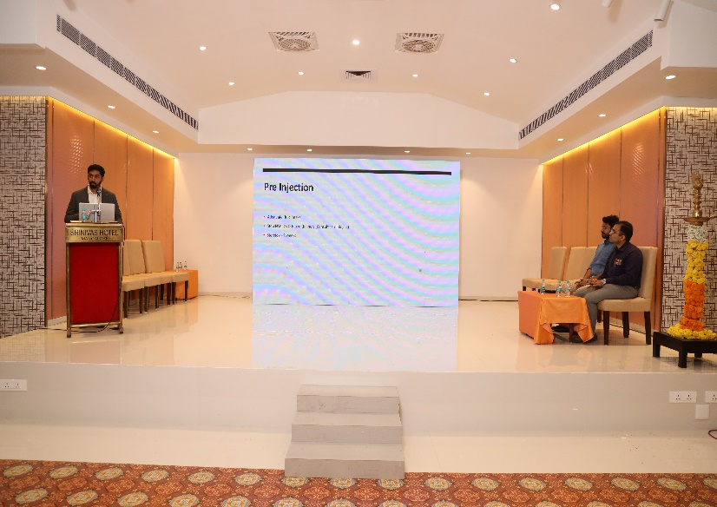
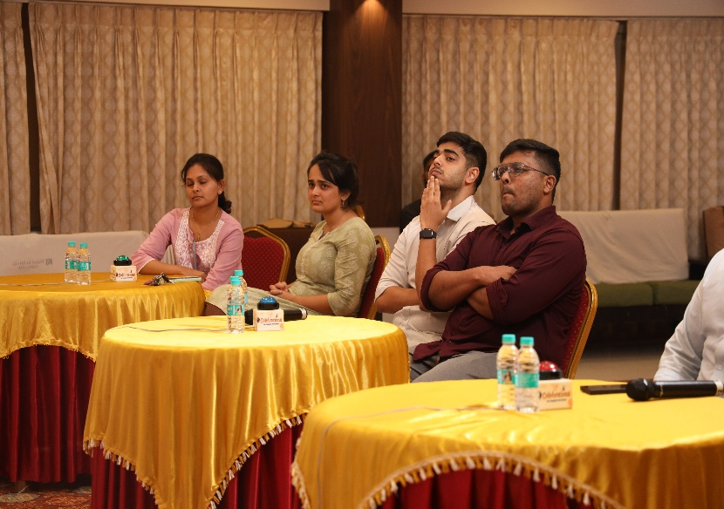
SRINIVAS INSTITUTE OF MEDICAL SCIENCES & RESEARCH CENTRE
SRINIVASNAGAR, MUKKA, MANGALORE – 574146. D.K
INTERACTION

Slide 5

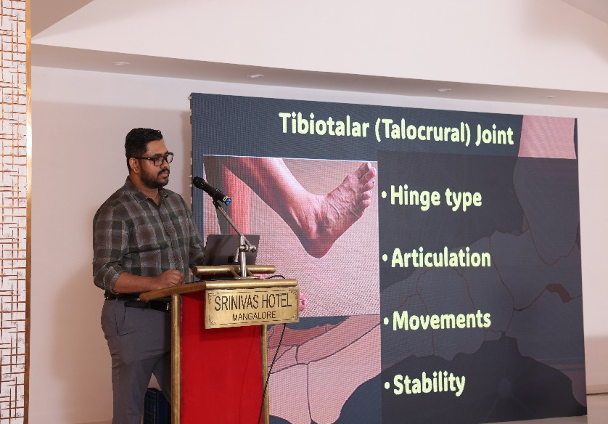
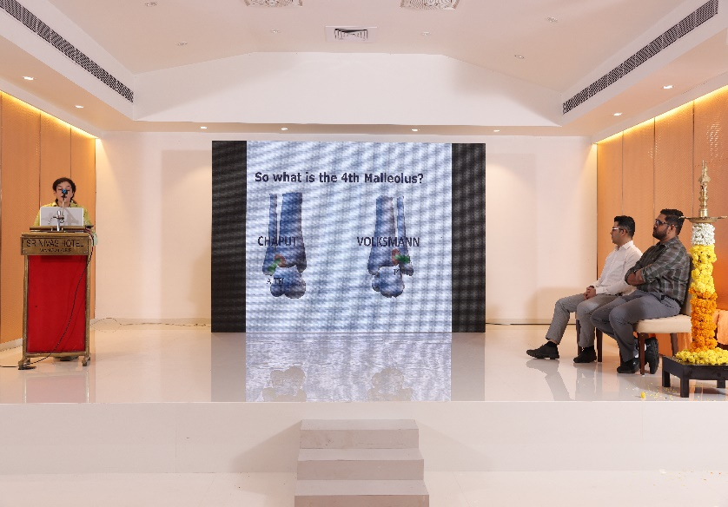
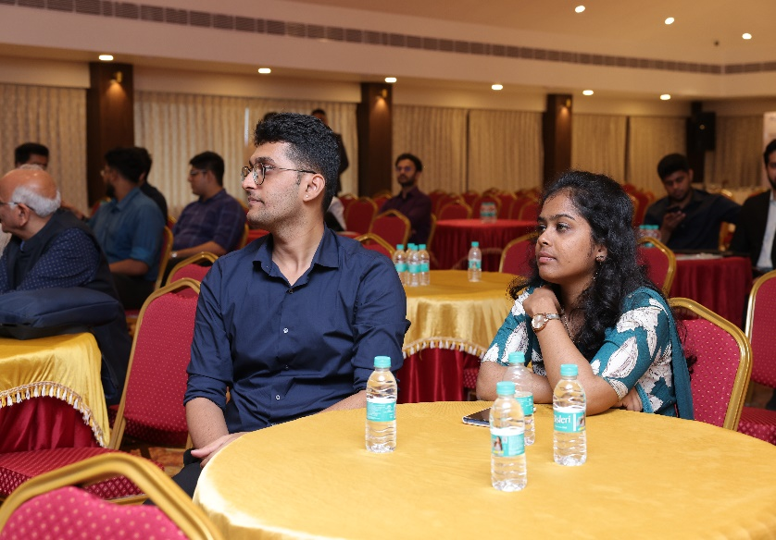
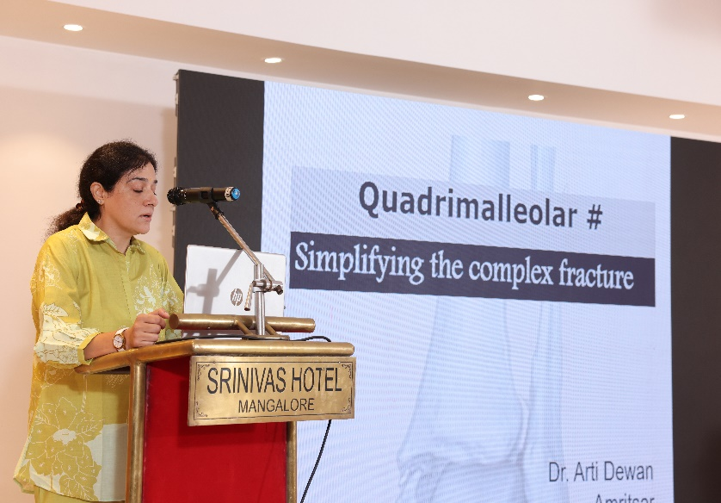
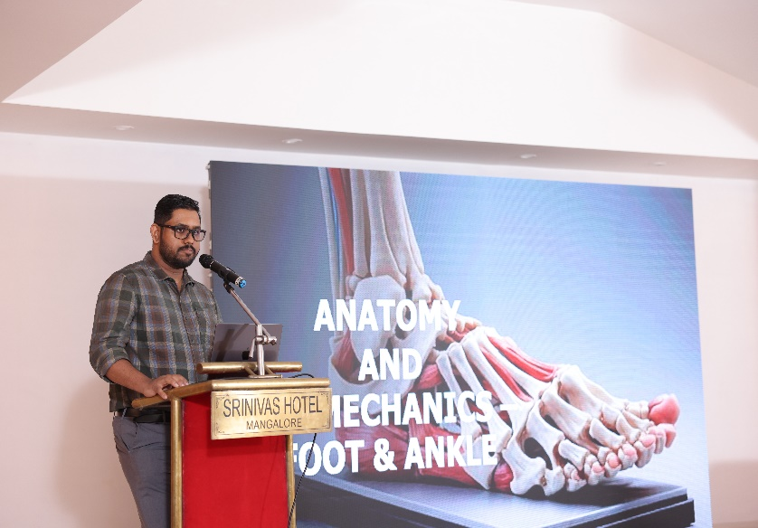
SRINIVAS INSTITUTE OF MEDICAL SCIENCES & RESEARCH CENTRE
SRINIVASNAGAR, MUKKA, MANGALORE – 574146. D.K
INTERACTION

Slide 6
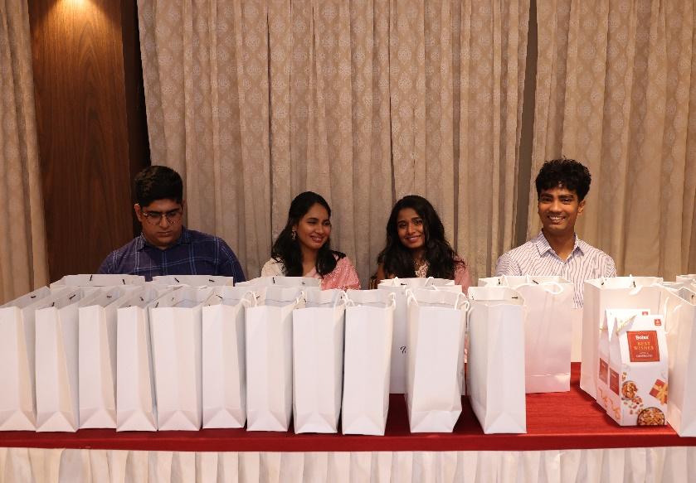
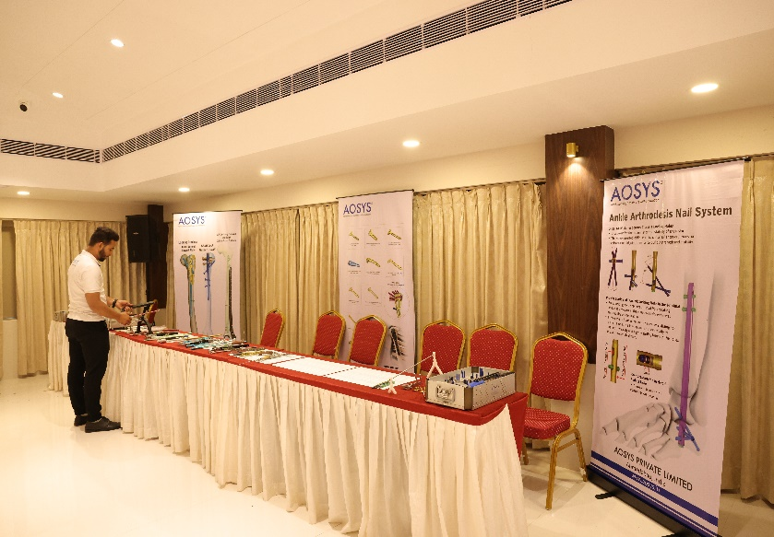
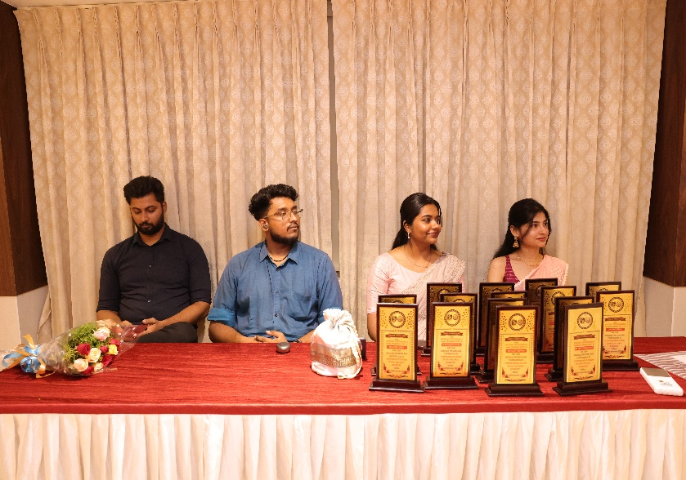
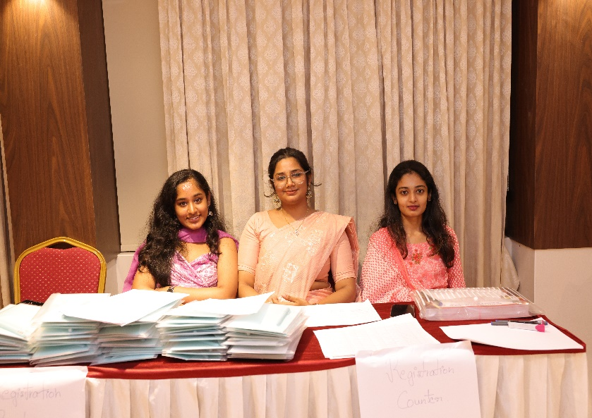
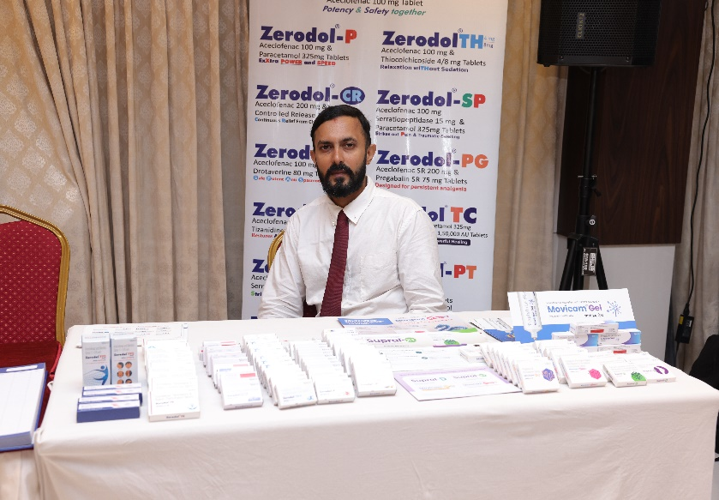
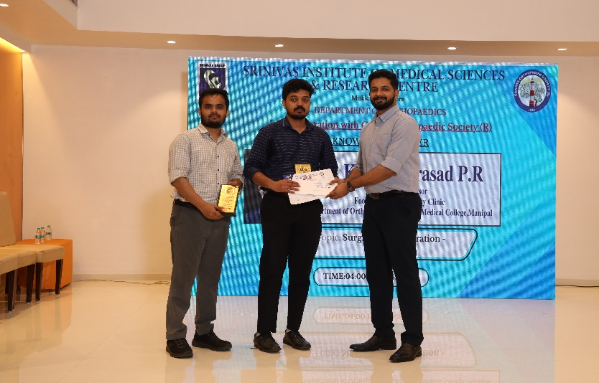
SRINIVAS INSTITUTE OF MEDICAL SCIENCES & RESEARCH CENTRE
SRINIVASNAGAR, MUKKA, MANGALORE – 574146. D.K
INSIGHTS

Slide 7
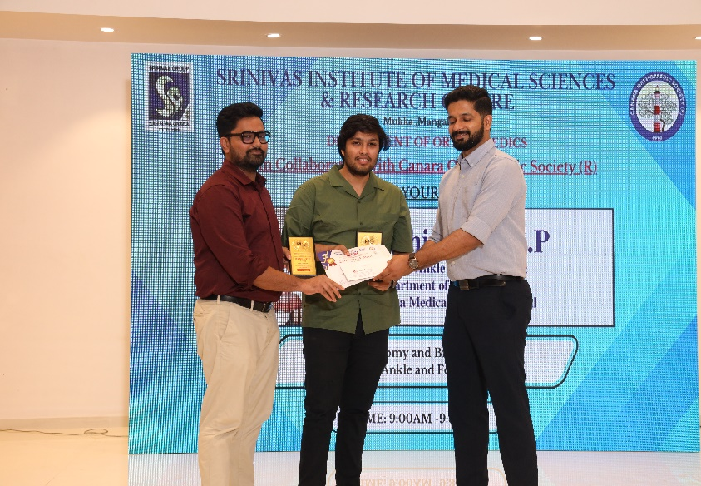
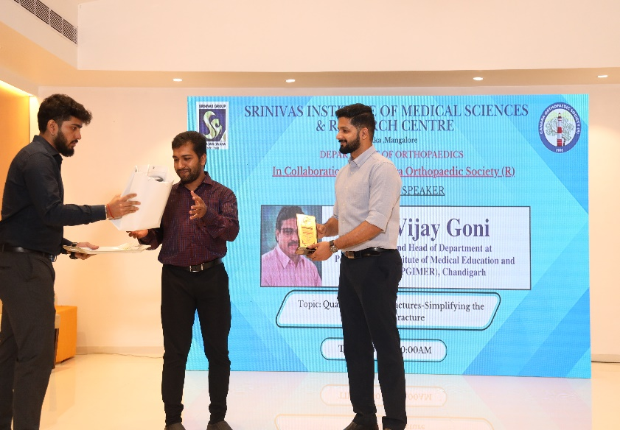
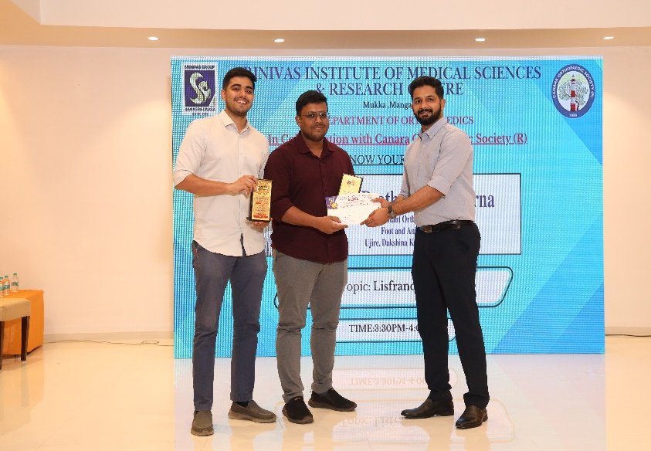
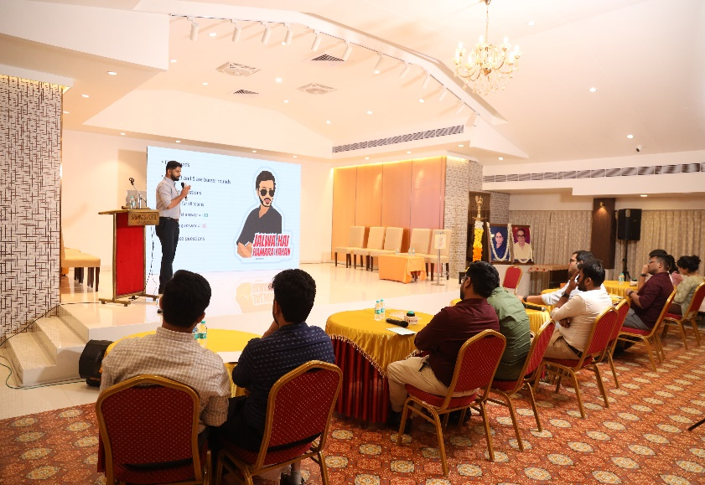
SRINIVAS INSTITUTE OF MEDICAL SCIENCES & RESEARCH CENTRE
SRINIVASNAGAR, MUKKA, MANGALORE – 574146. D.K
INSIGHTS

Slide 8
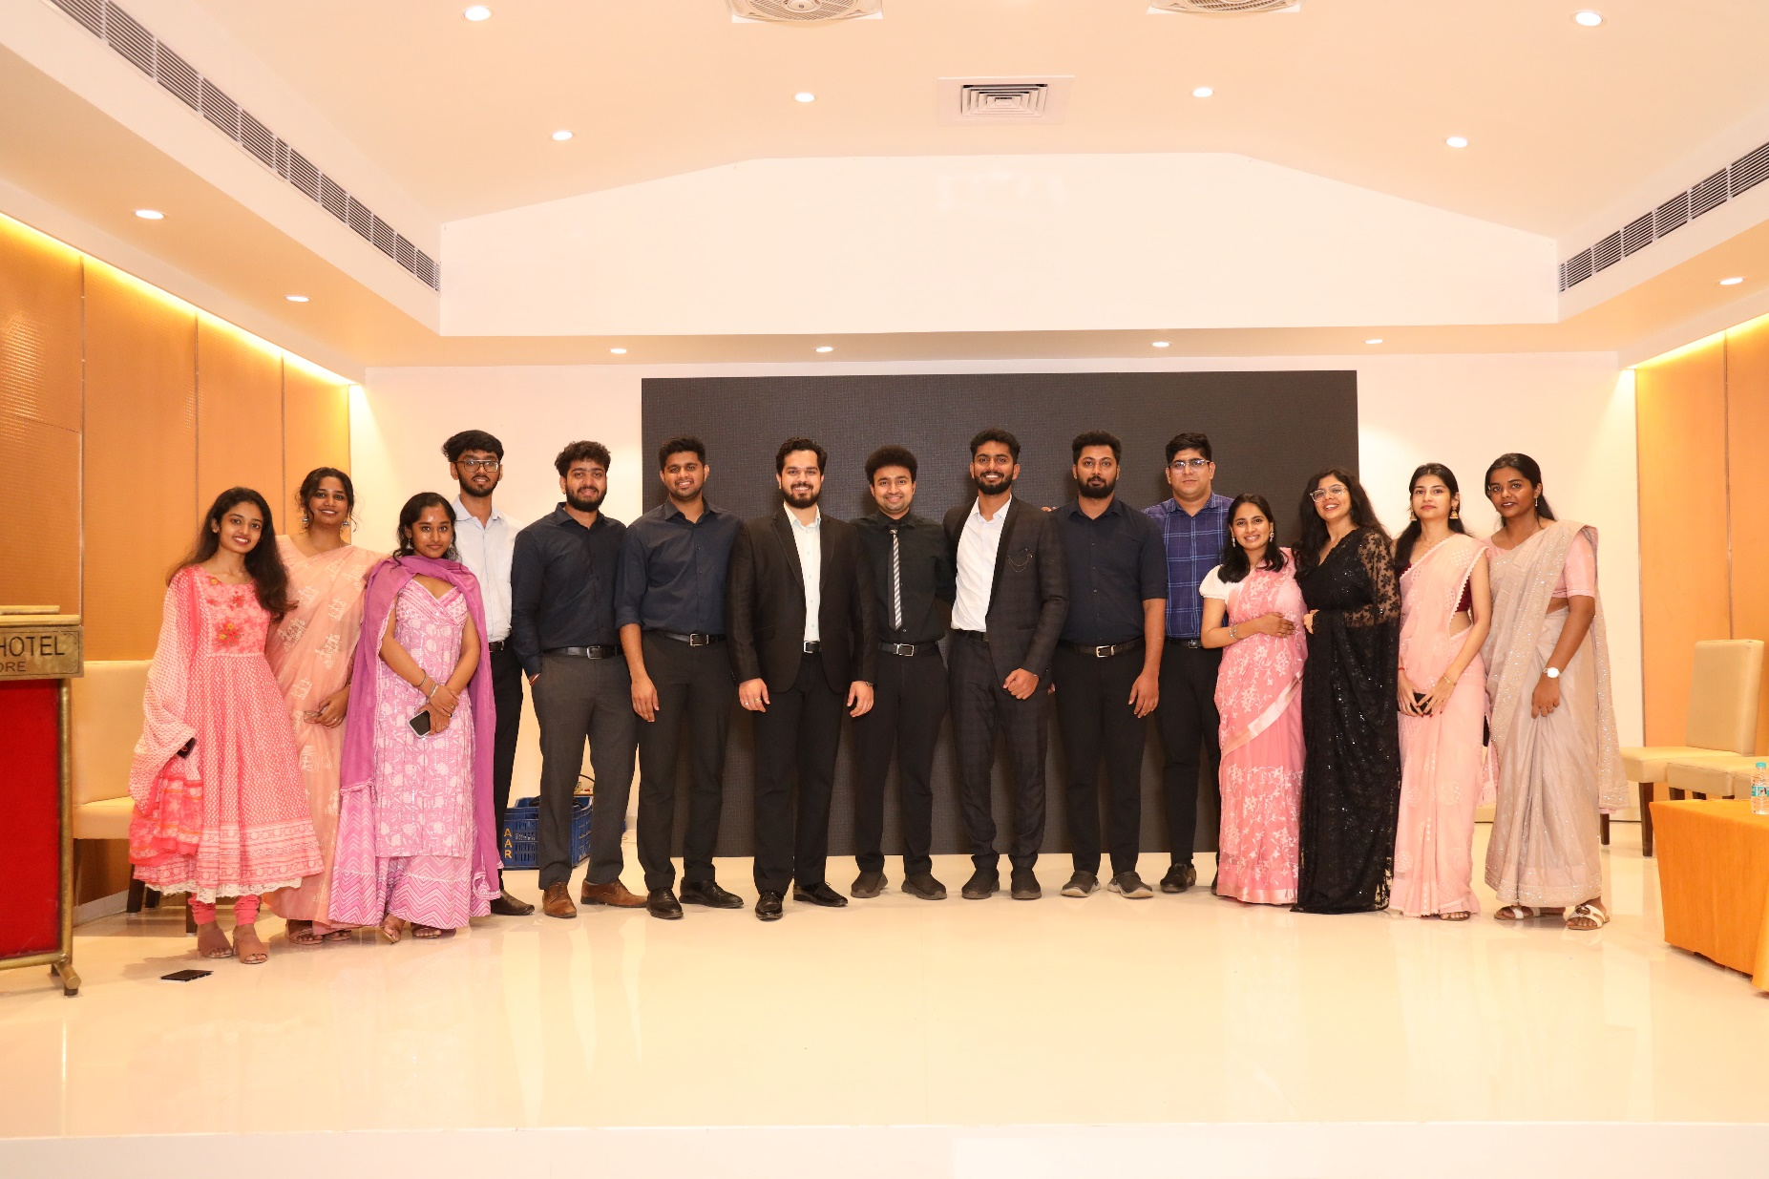
SRINIVAS INSTITUTE OF MEDICAL SCIENCES & RESEARCH CENTRE
SRINIVASNAGAR, MUKKA, MANGALORE – 574146. D.K
TEAM ORTHOPAEDICS

