Slide 1


SRINIVAS INSTITUTE OF MEDICAL SCIENCES & RESEARCH CENTRE
SRINIVASNAGAR, MUKKA, SURATHKAL, MANGALORE – 574146. D.K
ANATOMY CADAVERIC PROGRAMME
ANATOMY DEPARTMENT
06-11-2025

Slide 2
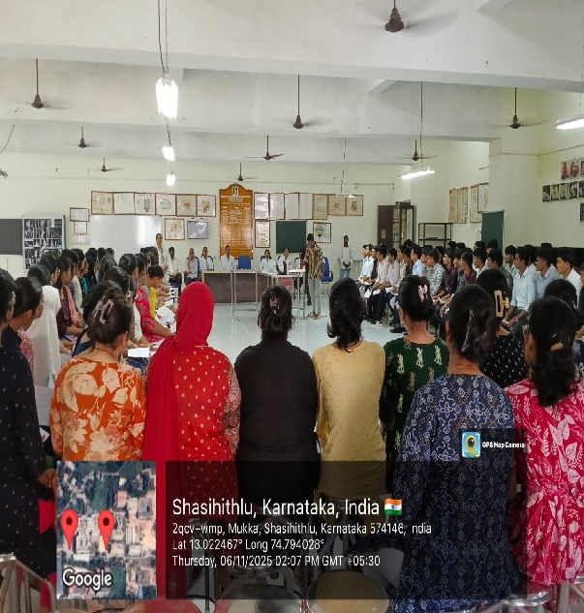
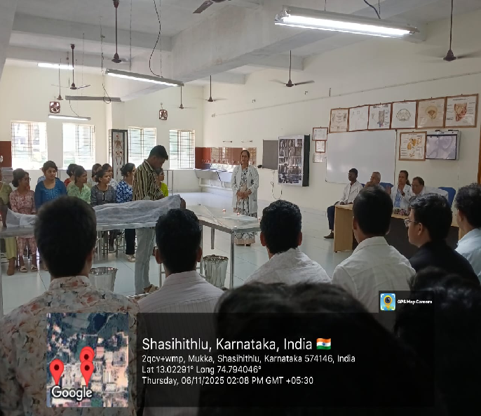
SRINIVAS INSTITUTE OF MEDICAL SCIENCES & RESEARCH CENTRE
SRINIVASNAGAR, MUKKA, SURATHKAL, MANGALORE – 574146. D.K
WELCOME NOTE

Slide 3
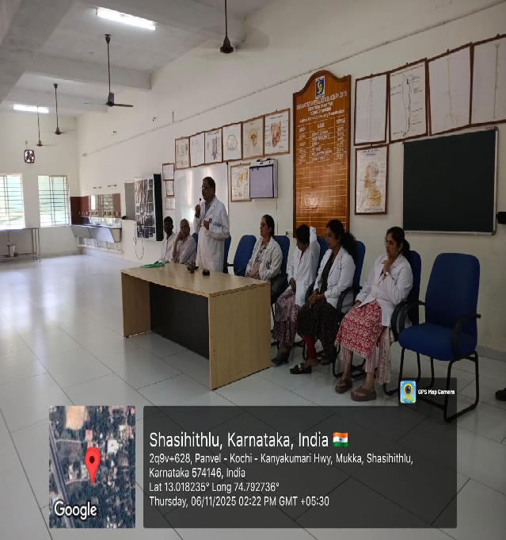
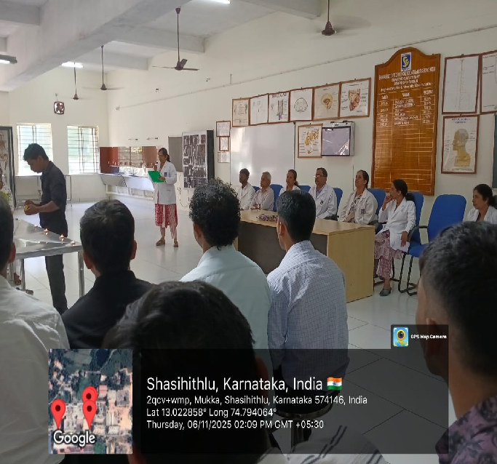
SRINIVAS INSTITUTE OF MEDICAL SCIENCES & RESEARCH CENTRE
SRINIVASNAGAR, MUKKA, SURATHKAL, MANGALORE – 574146. D.K
PURPOSE OF THE EVENT

Slide 4
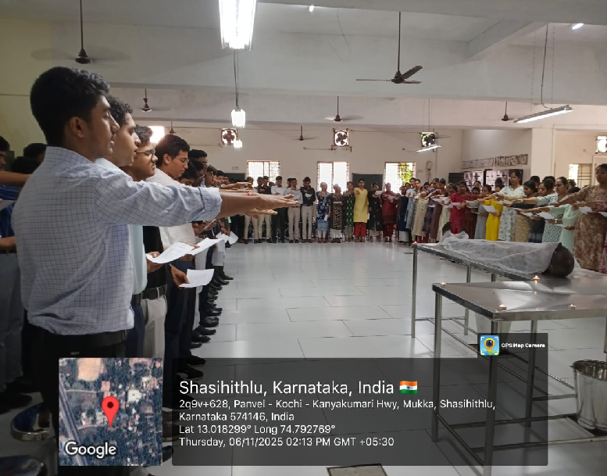
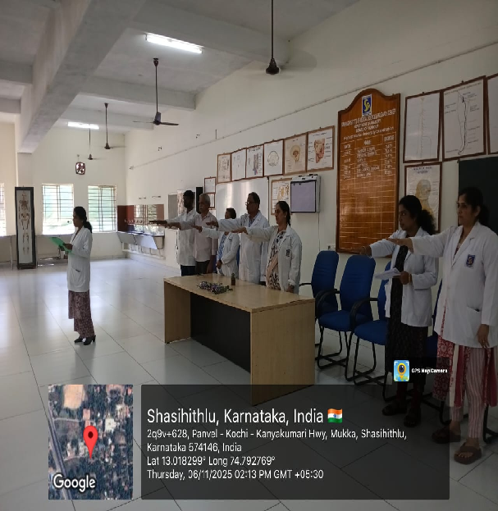
SRINIVAS INSTITUTE OF MEDICAL SCIENCES & RESEARCH CENTRE
SRINIVASNAGAR, MUKKA, SURATHKAL, MANGALORE – 574146. D.K
CADAVERIC OATH

Slide 5
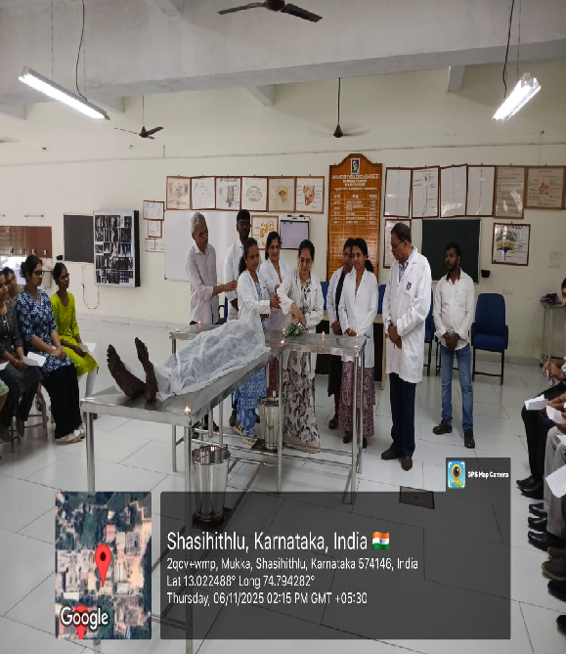
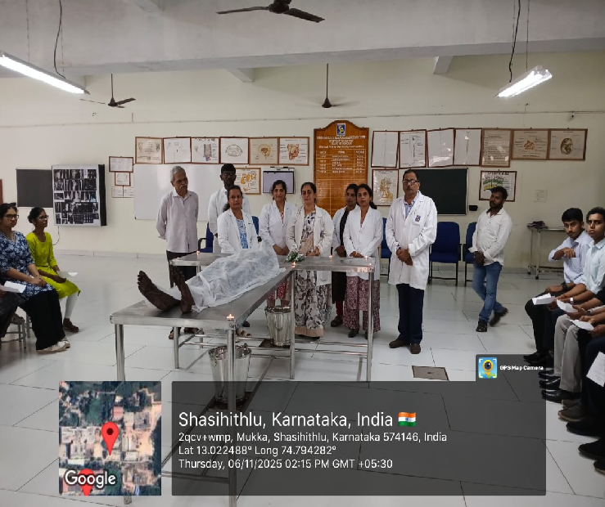
SRINIVAS INSTITUTE OF MEDICAL SCIENCES & RESEARCH CENTRE
SRINIVASNAGAR, MUKKA, SURATHKAL, MANGALORE – 574146. D.K
PAYING RESPECT TO THE FIRST TEACHER

Slide 6
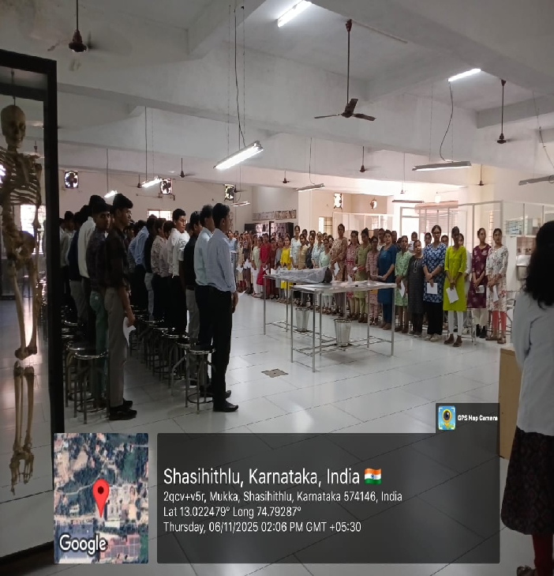
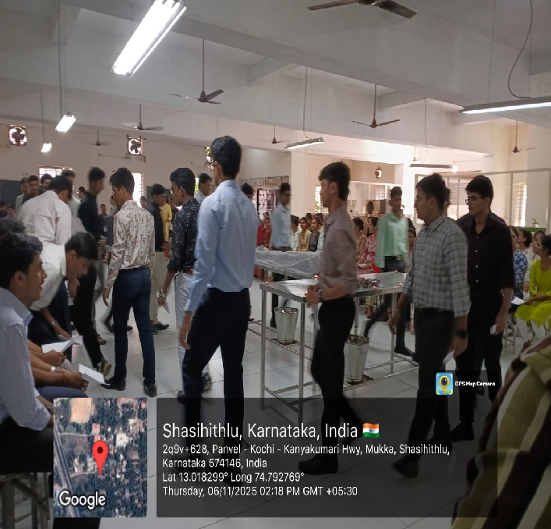
SRINIVAS INSTITUTE OF MEDICAL SCIENCES & RESEARCH CENTRE
SRINIVASNAGAR, MUKKA, SURATHKAL, MANGALORE – 574146. D.K
PAYING RESPECT TO THE FIRST TEACHER

Slide 7
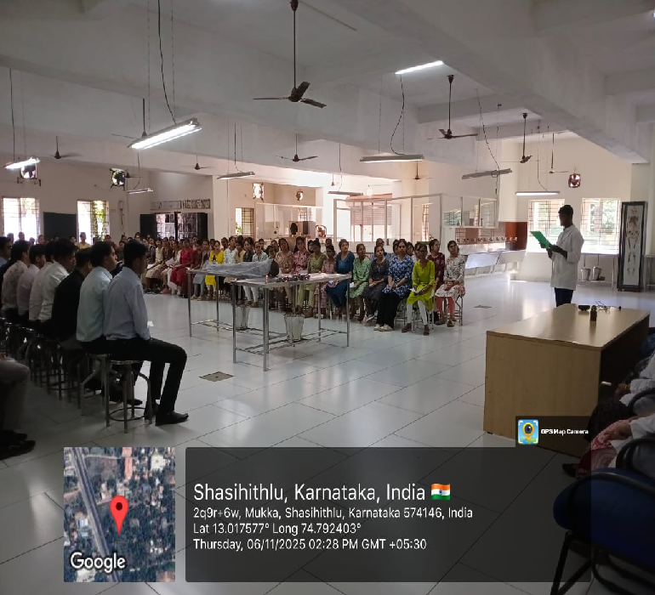
SRINIVAS INSTITUTE OF MEDICAL SCIENCES & RESEARCH CENTRE
SRINIVASNAGAR, MUKKA, SURATHKAL, MANGALORE – 574146. D.K
VOTE OF THANKS

